Slide 1
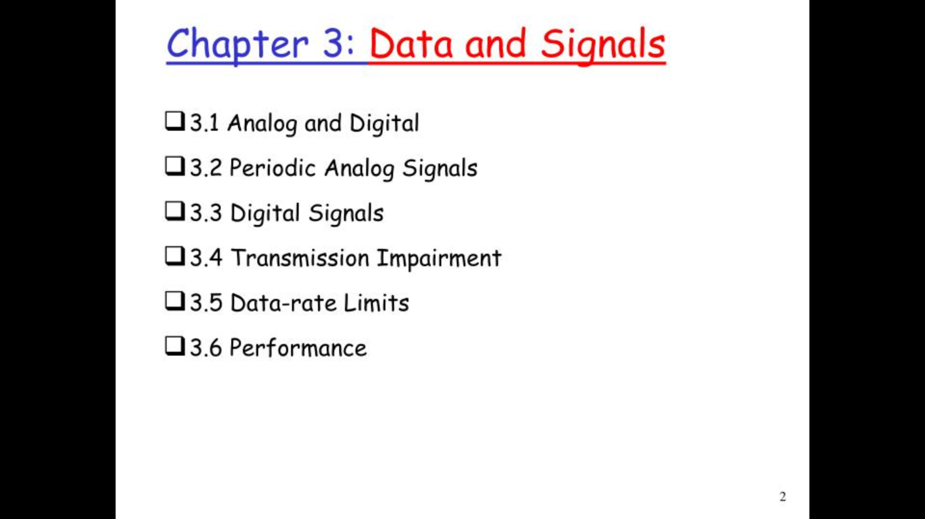

Slide 2
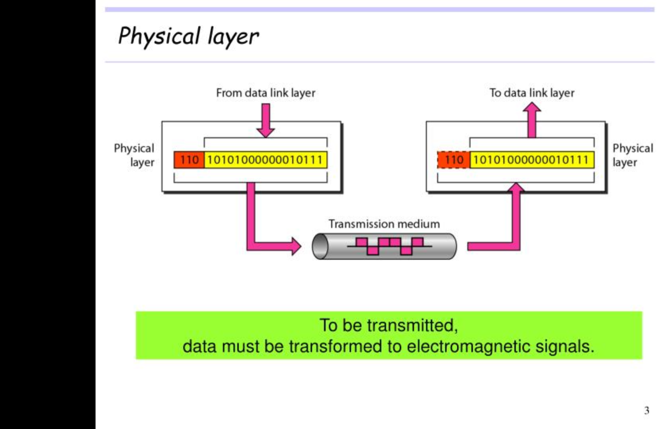

Slide 3
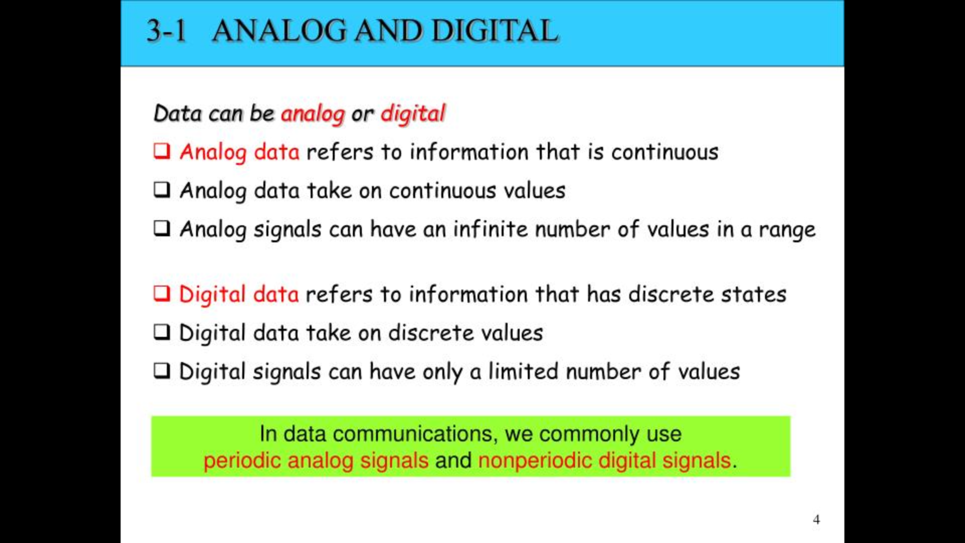
Notes:
A periodic signal is a signal that repeats itself at regular intervals of time.
a non-periodic signal is a signal that does not repeat itself at regular intervals.

Slide 4
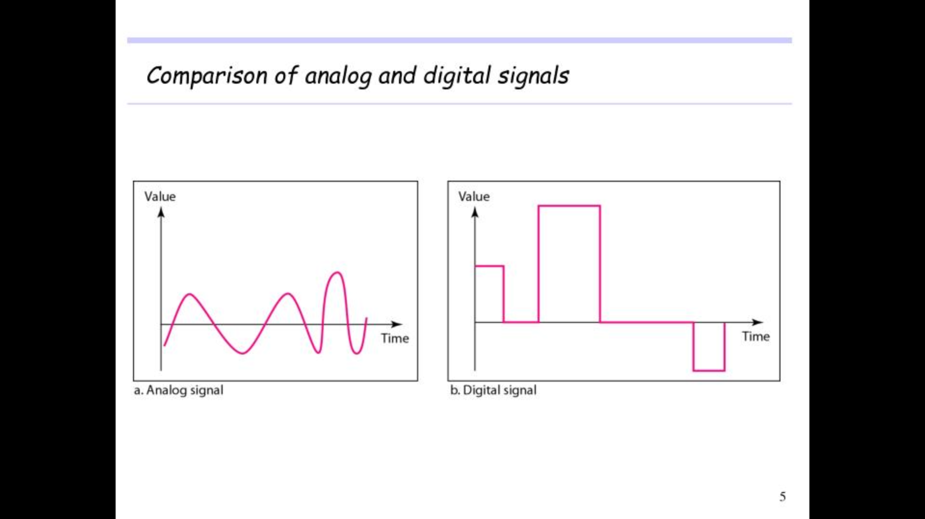

Slide 5
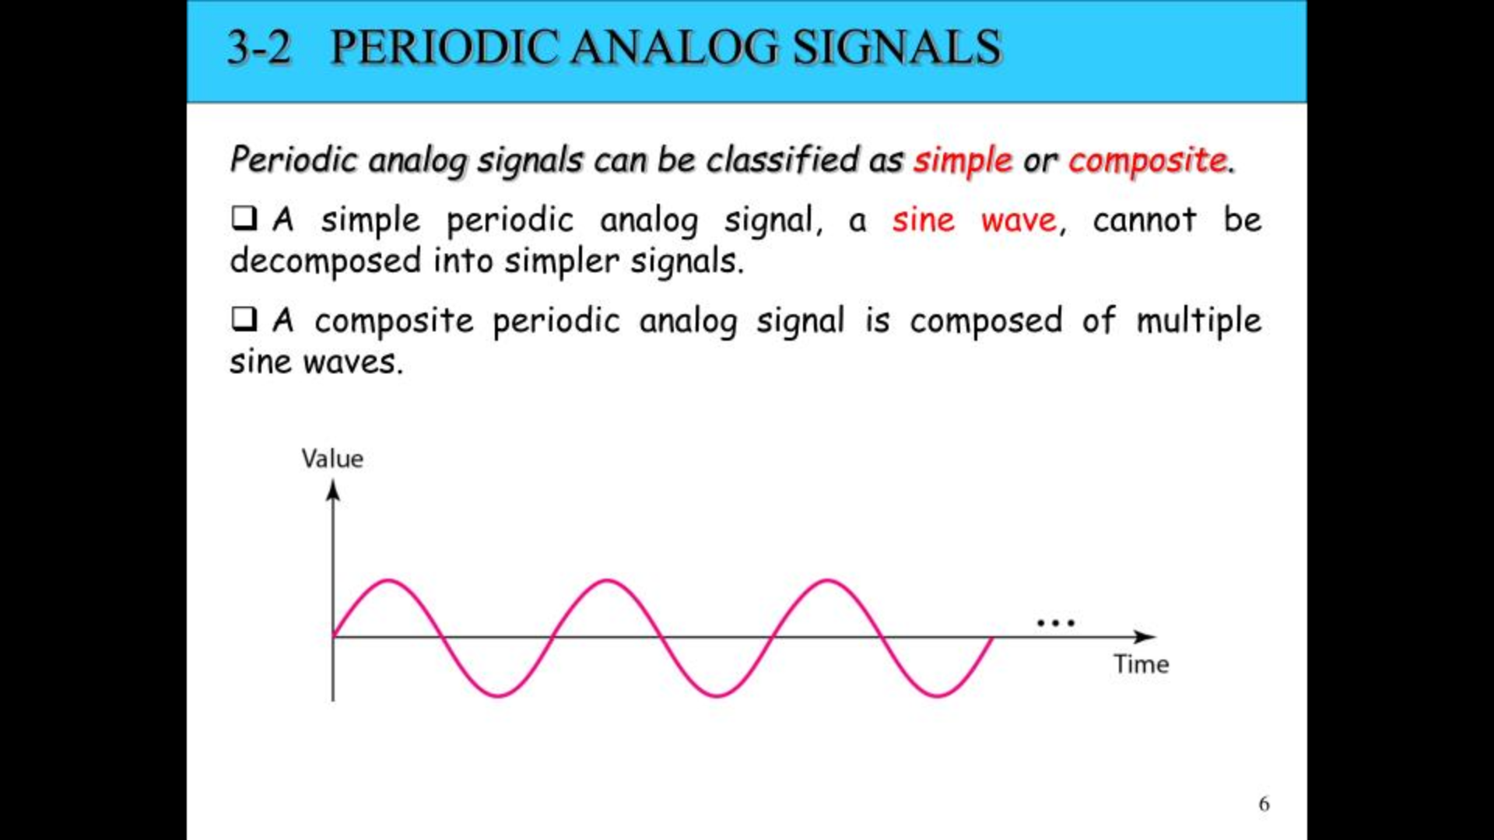

Slide 6
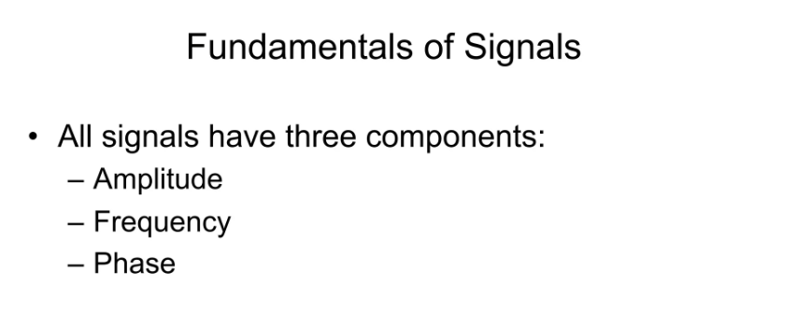

Slide 7
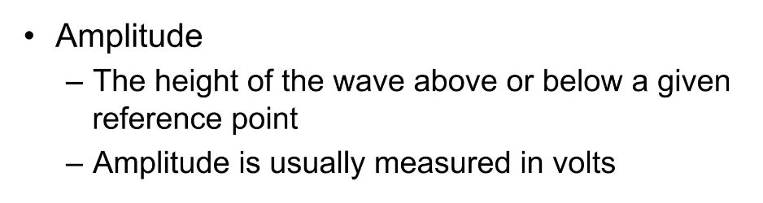

Slide 8
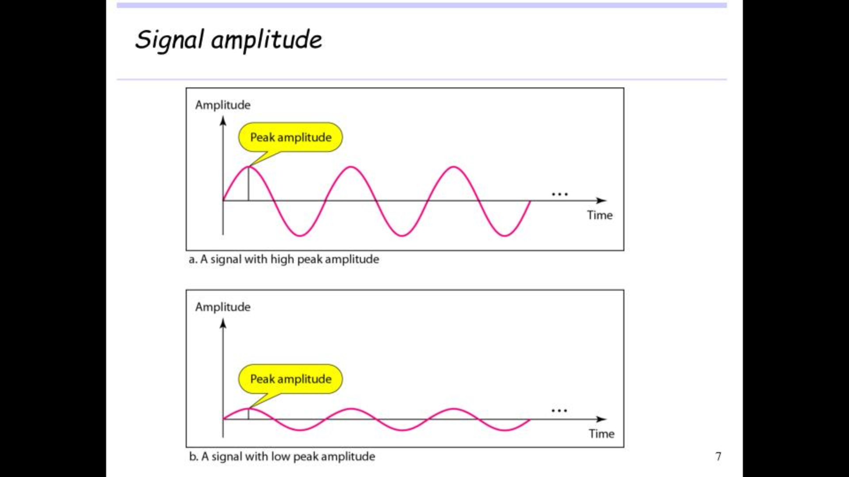

Slide 9
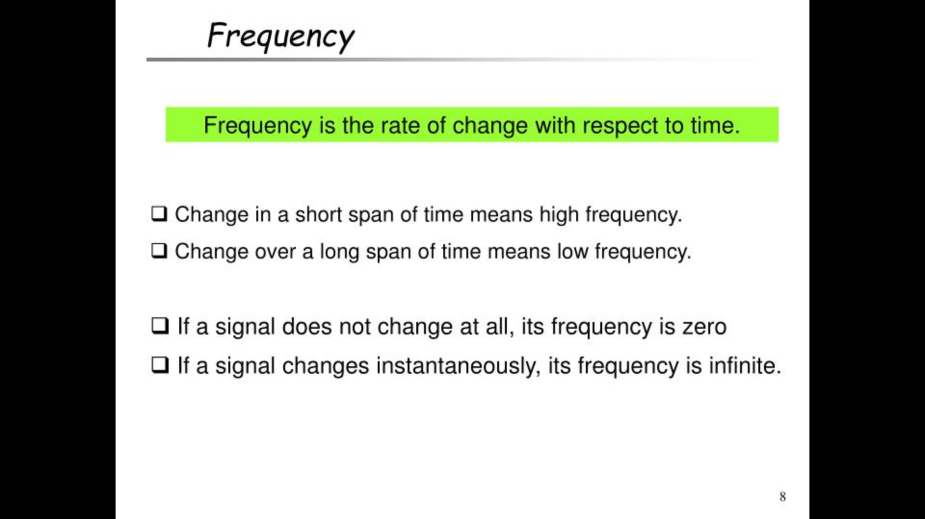

Slide 10
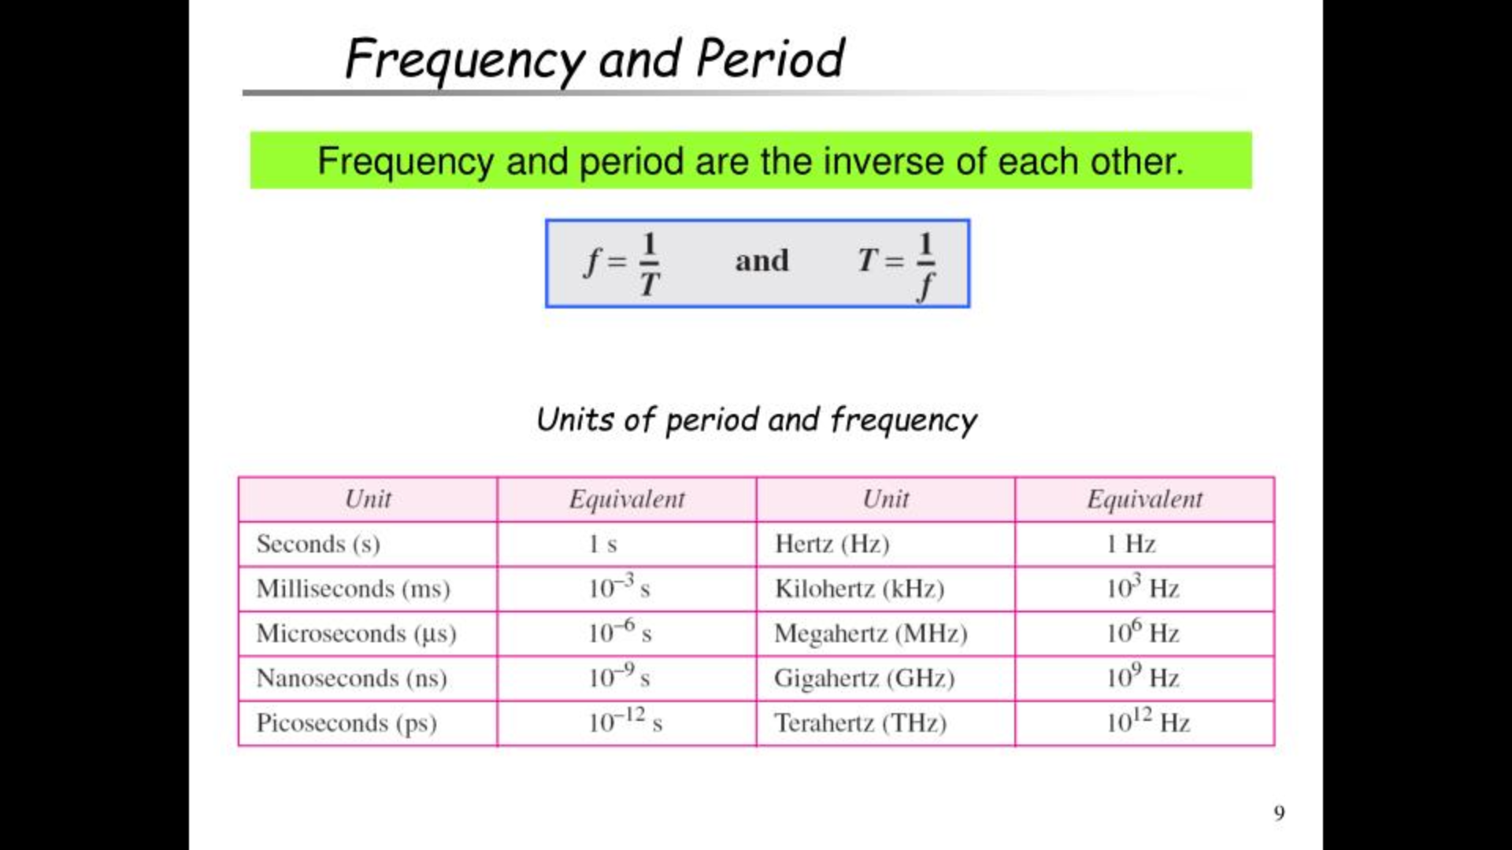
Notes:
10³ = 10 × 10 × 10
= 100 × 10
= 1000
Therefore, 1000 is the 3rd power of 10.

Slide 11
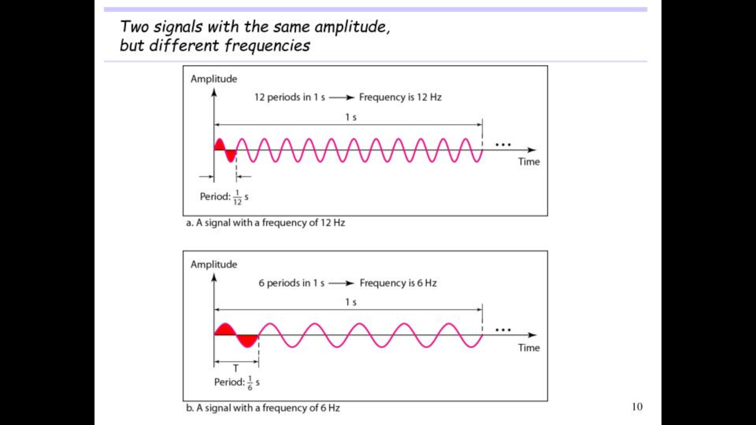

Slide 12
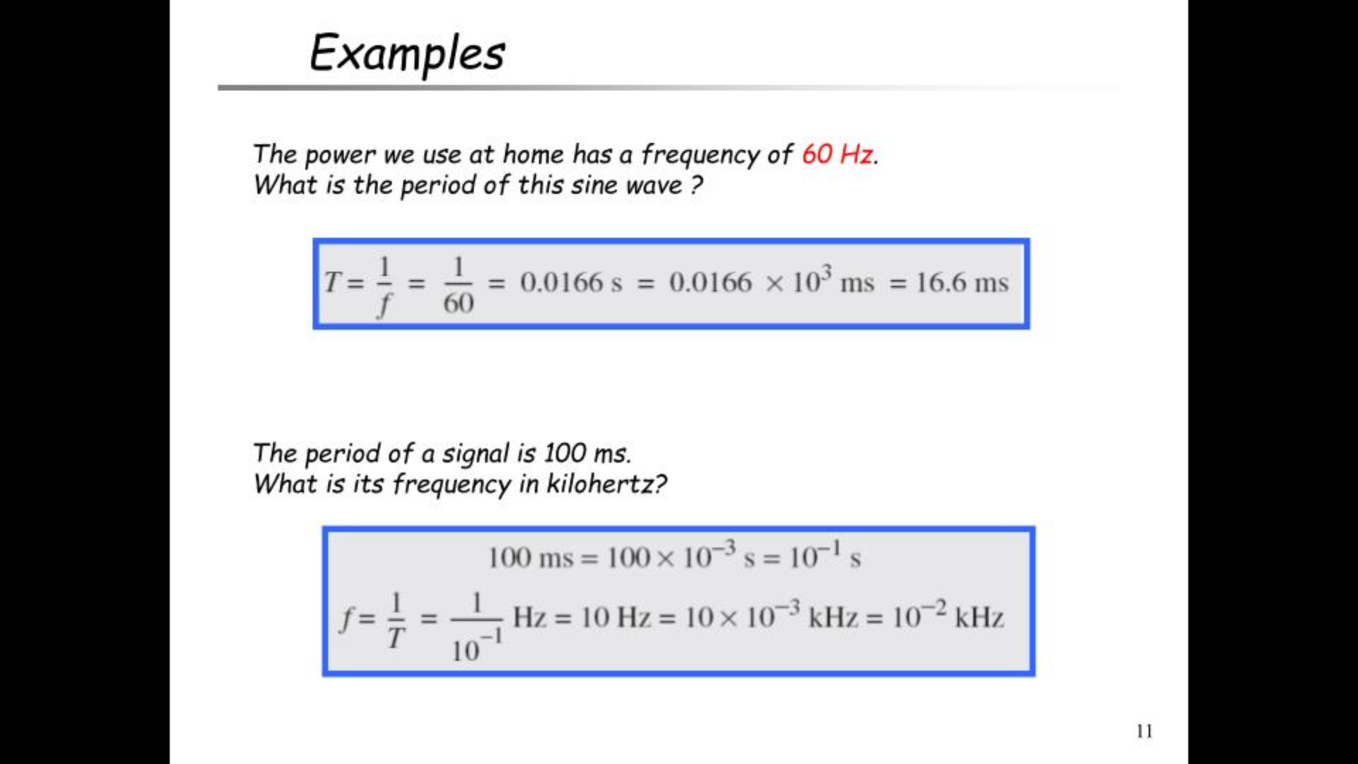
Notes:
10³ = 10 × 10 × 10
= 100 × 10
= 1000
Therefore, 1000 is the 3rd power of 10.

Slide 13
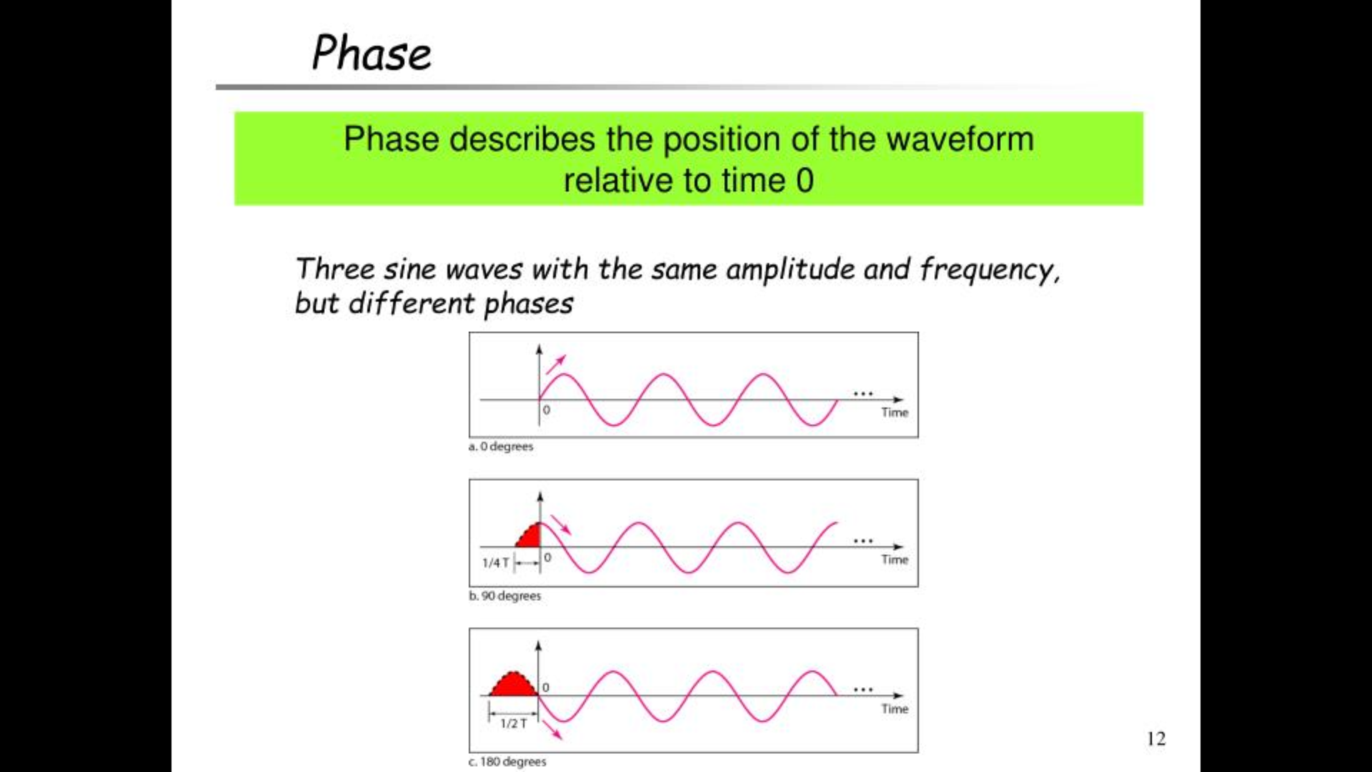

Slide 14
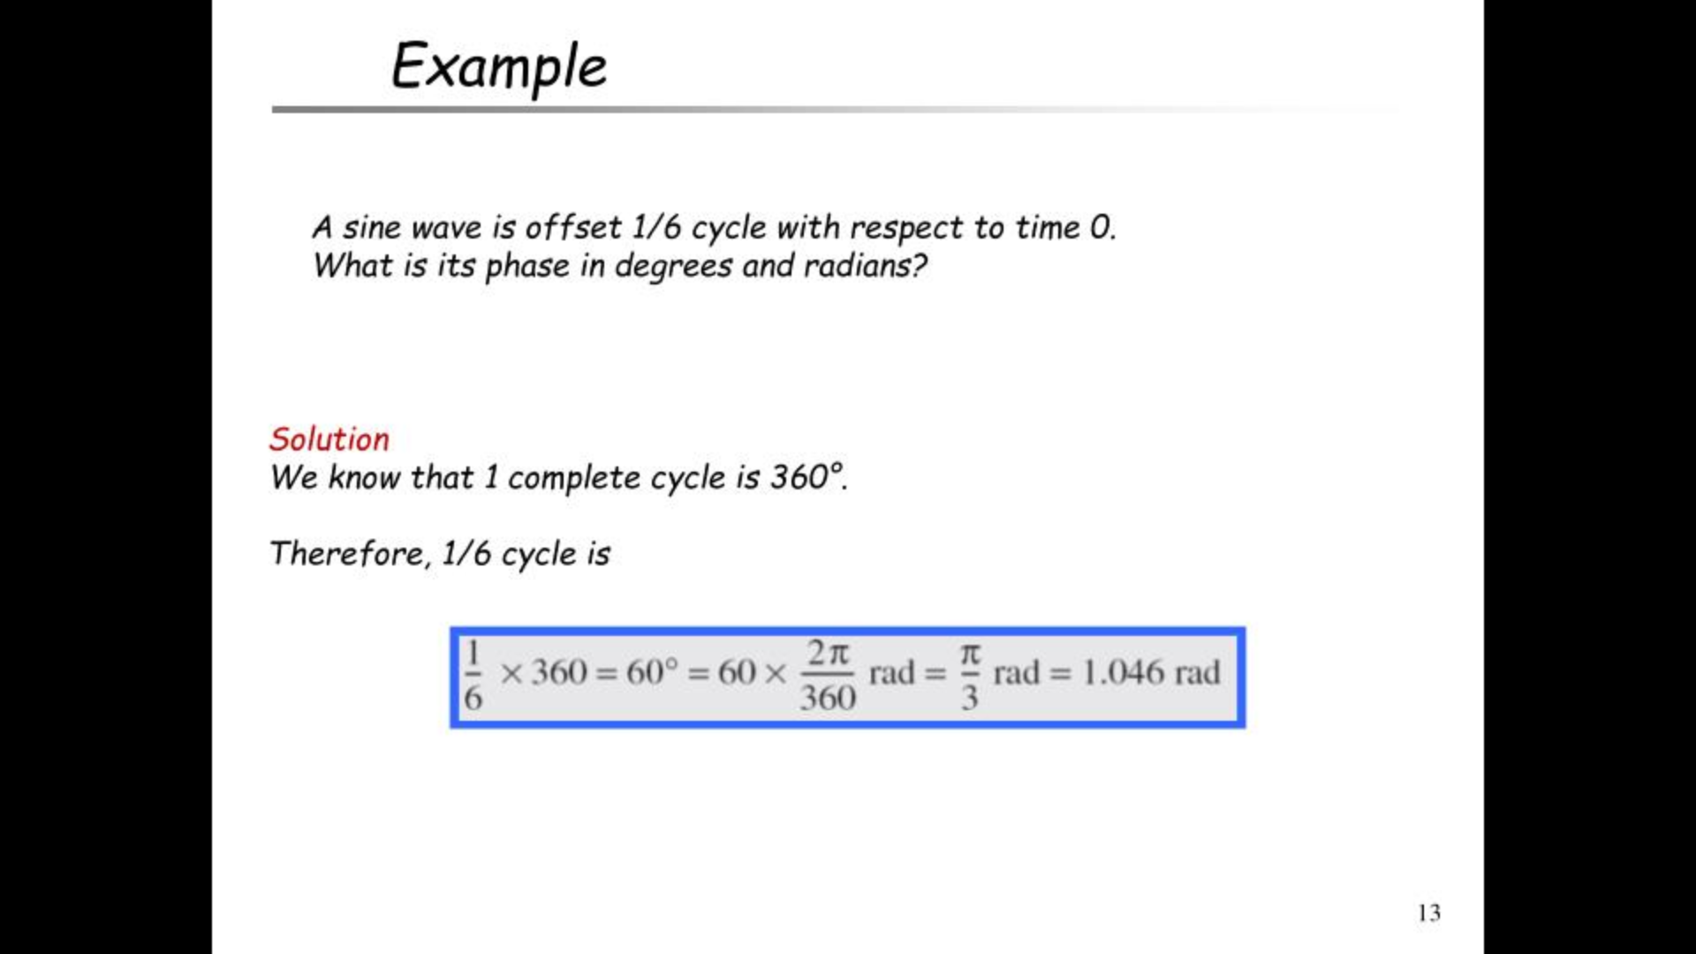
Angle in degree | Angle in radian
0° | 0
30° | π/6
45° | π/4
60° | π/3
90° | π/2
180º | π
270º | (3π)/2
360º | 2π
Notes:
given angle = 270 degrees
Angle in radian = Angle in degree x (π/180)
= 270 x (π/180)
= 2π/3
Hence, 270 degrees is equal to 2π/3 radian.
Degrees to Radians Formula
Degrees to Radians conversion is very important and can be achieved by the formulas listed below:
Degrees × (π/180) = Radians
Radians × (180/π) = Degrees
180 degrees = π radians

Slide 15
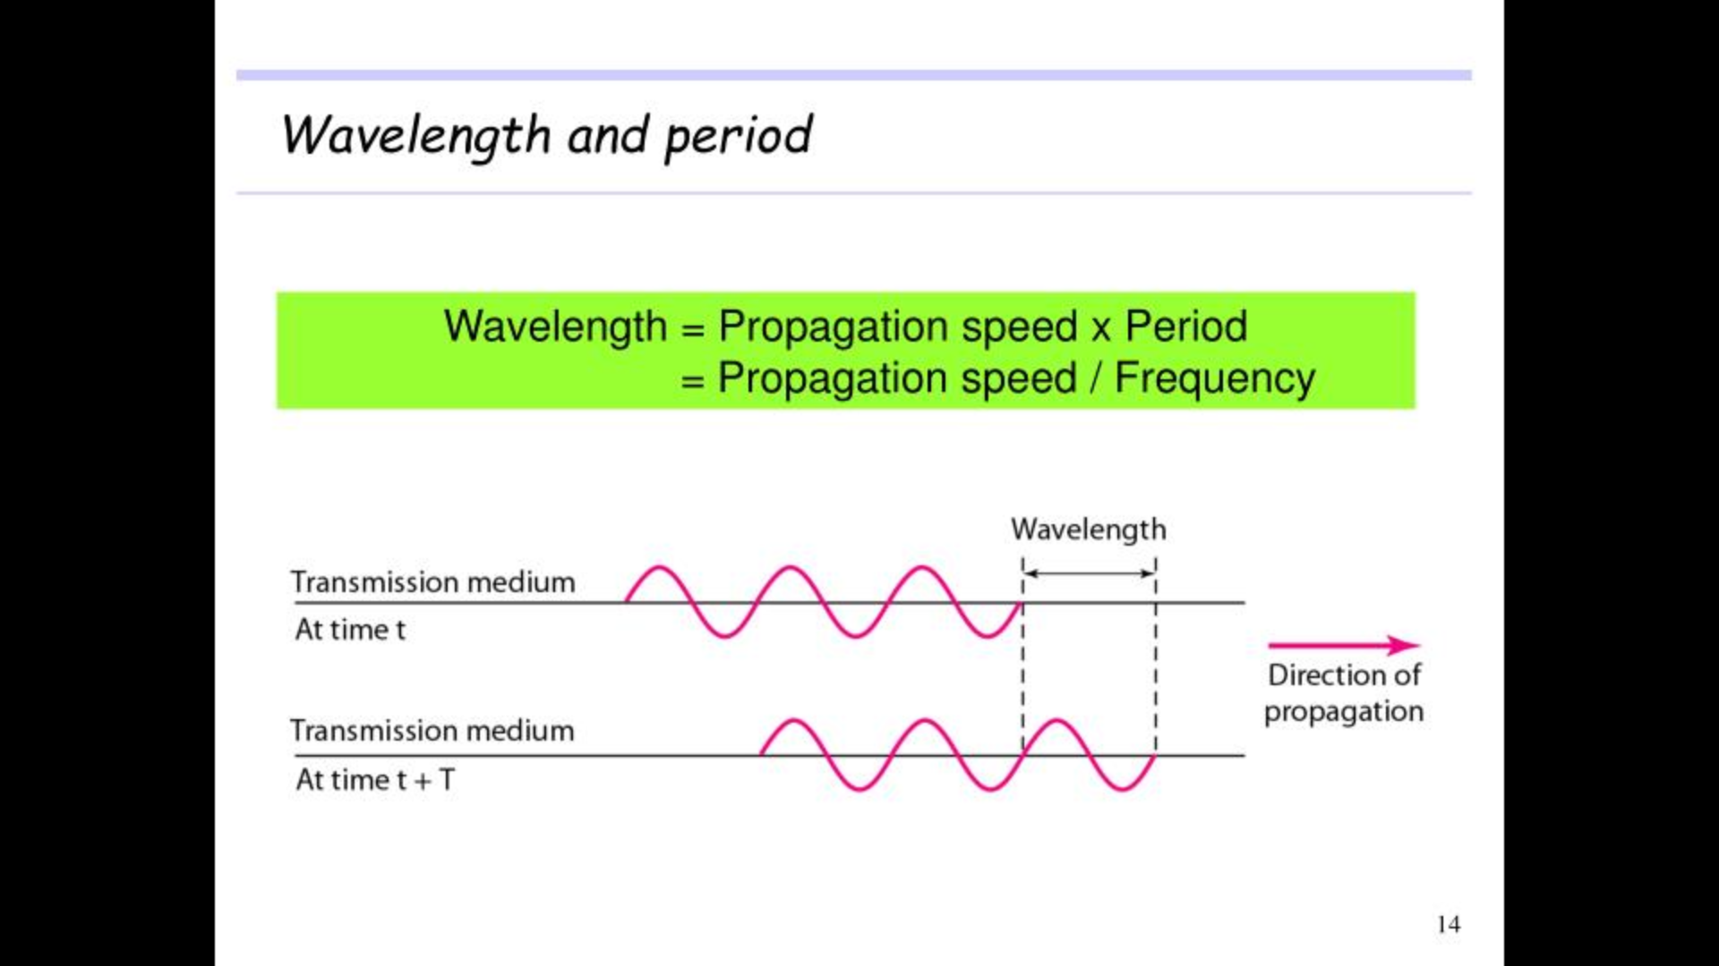

Slide 16
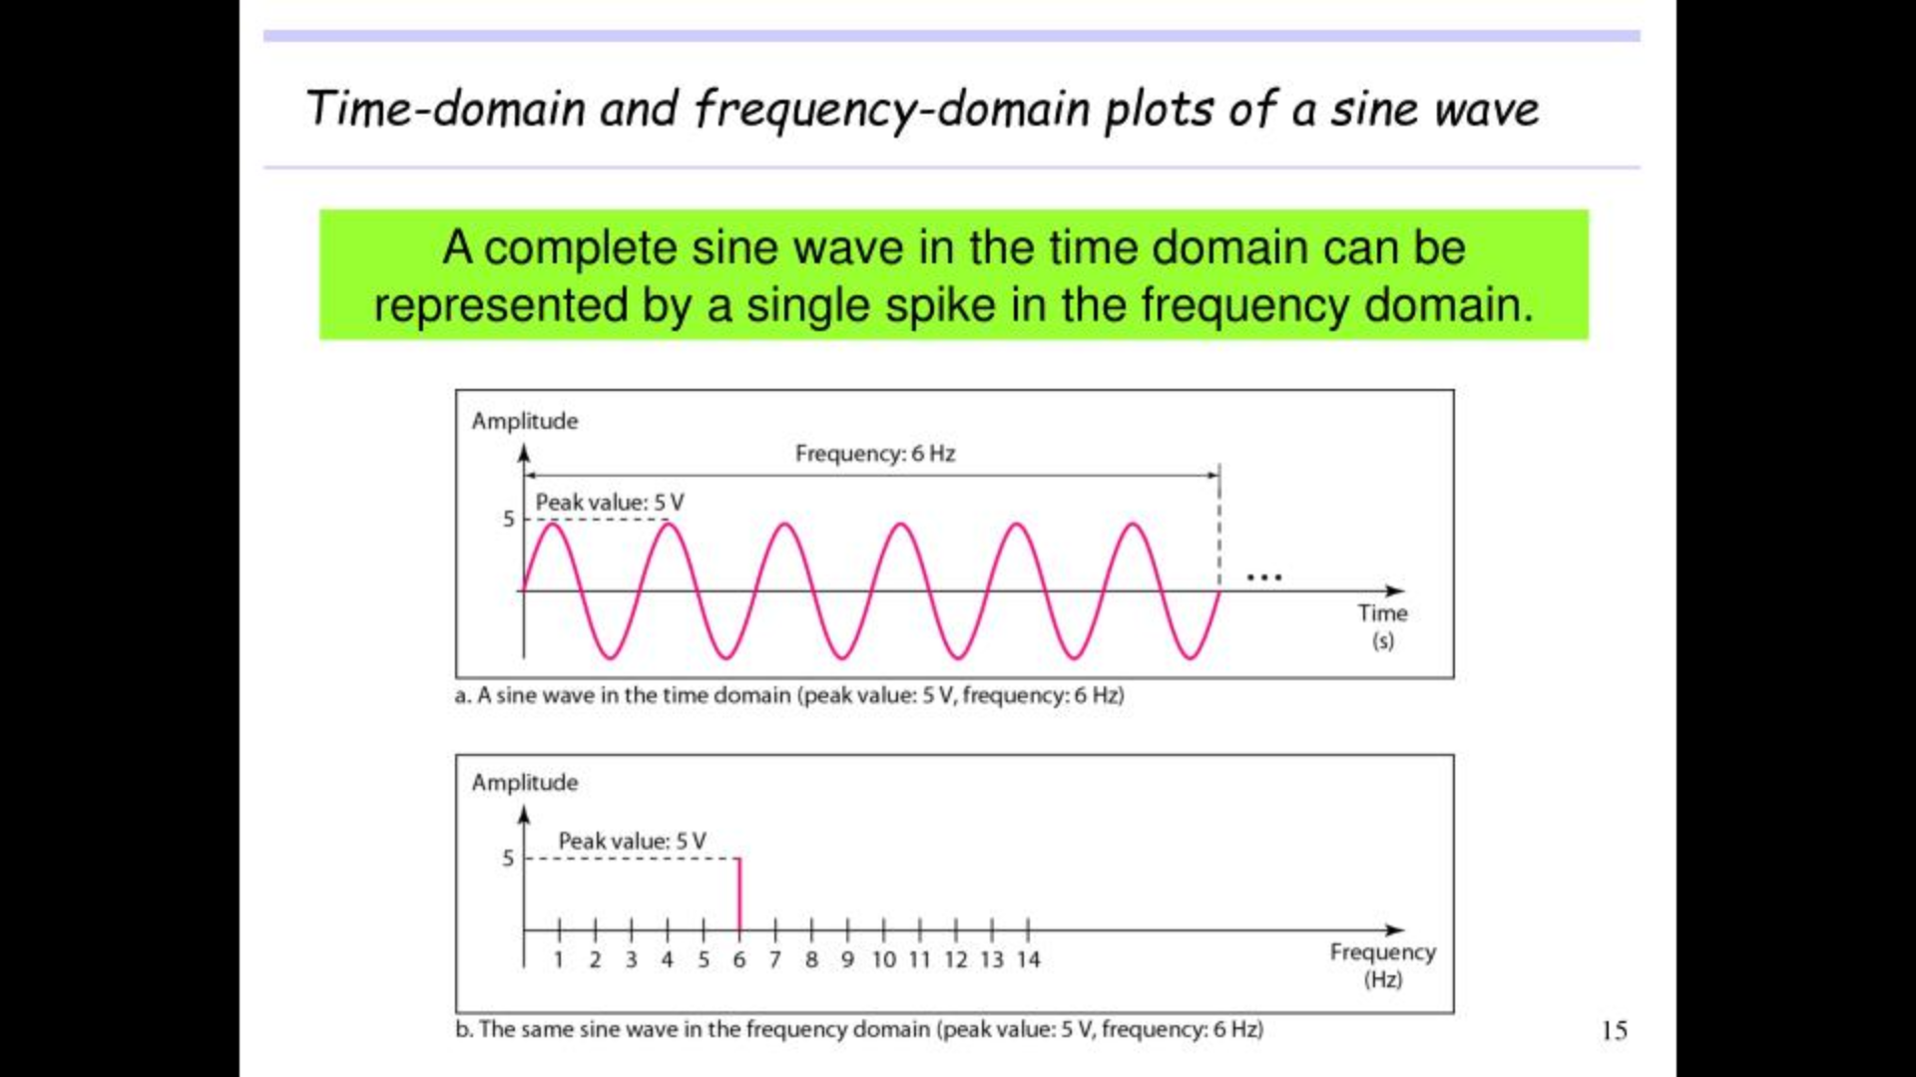

Slide 17
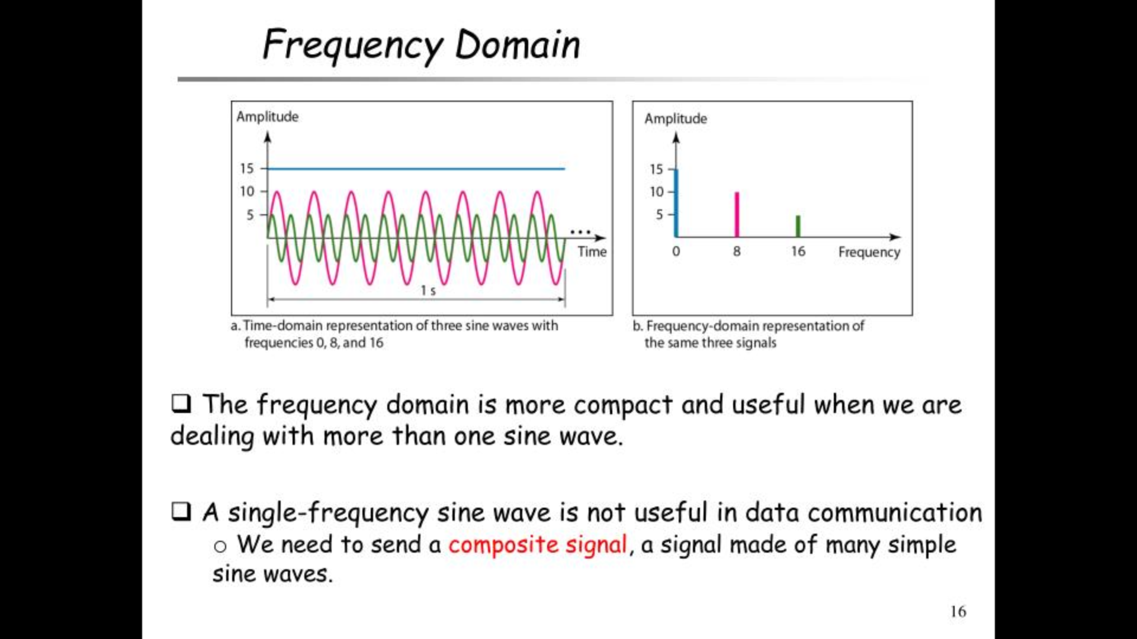
Notes:
Many useful wave forms do not change in a single smooth curve between a minimum and a maximum amplitude; they jump, slide, wobble, spike, and dip
Composite signal is a combination of simple sine waves with different frequency, amplitudes, and phases

Slide 18
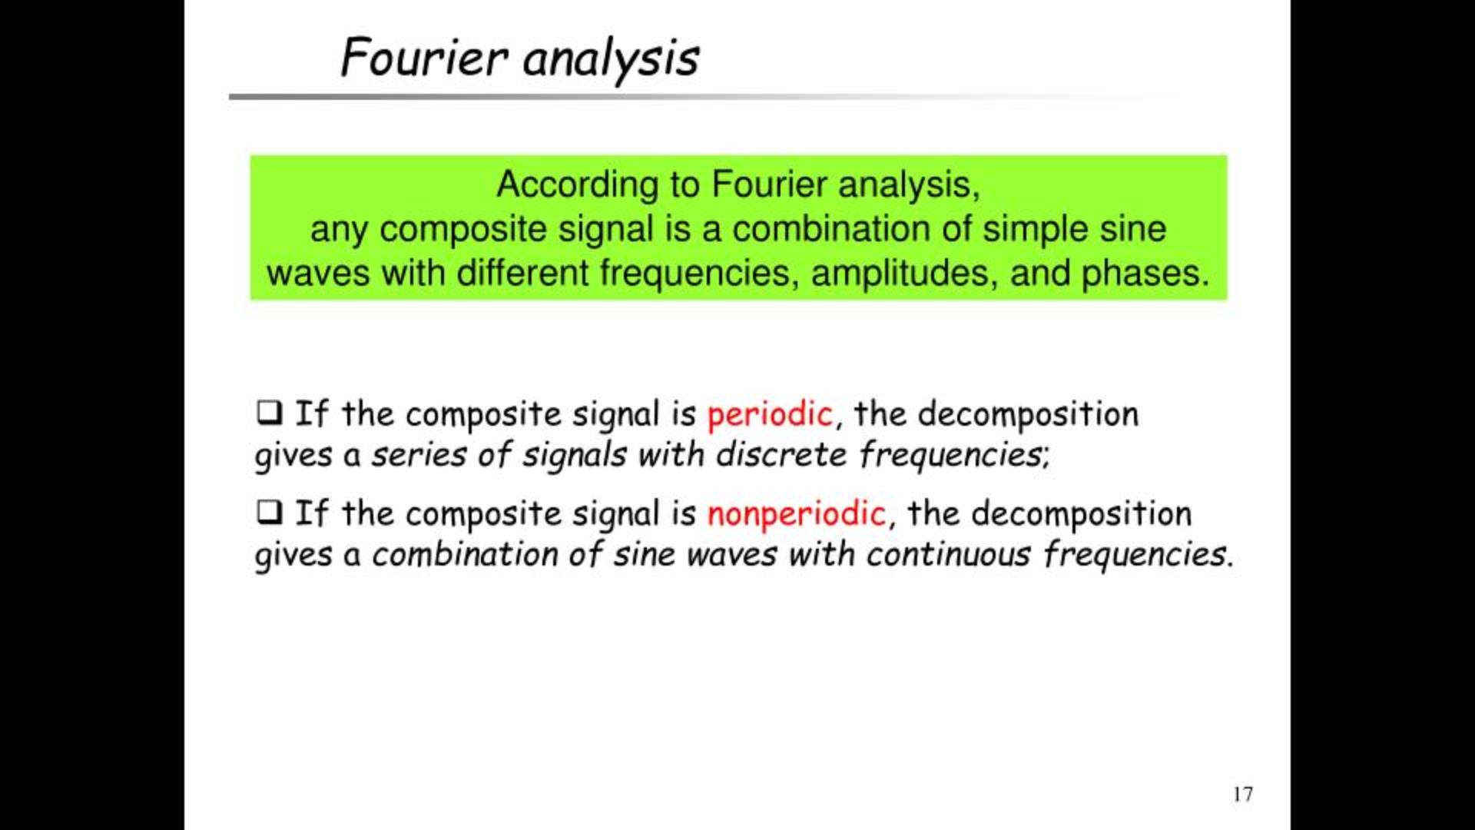
Notes:
A periodic signal is a signal that repeats itself at regular intervals of time.
a non-periodic signal is a signal that does not repeat itself at regular intervals.

Slide 19
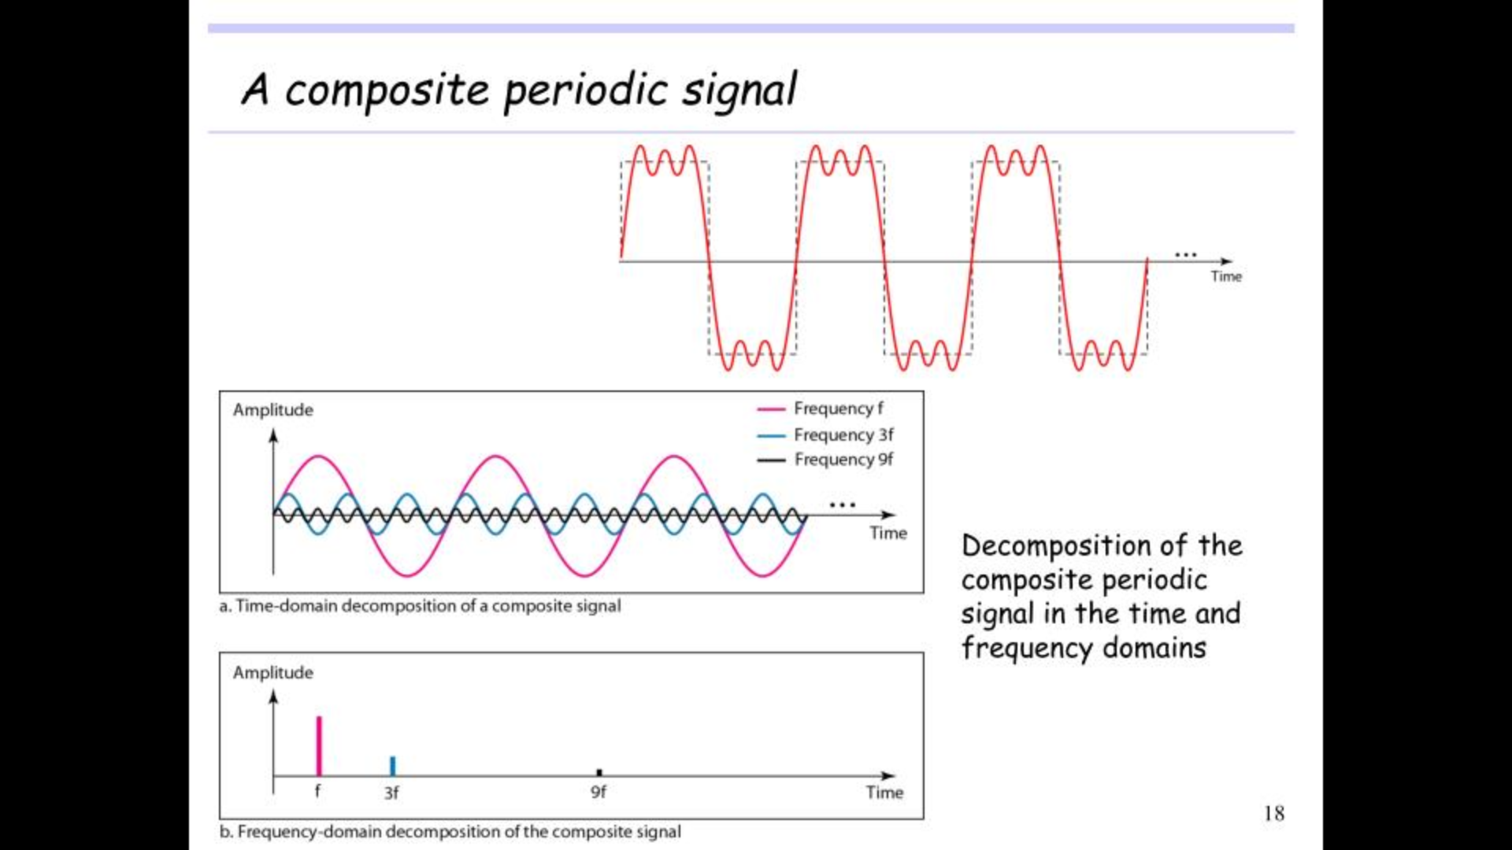
Notes:
Composite signal is a combination of simple sine waves with different frequency, amplitudes, and phases

Slide 20
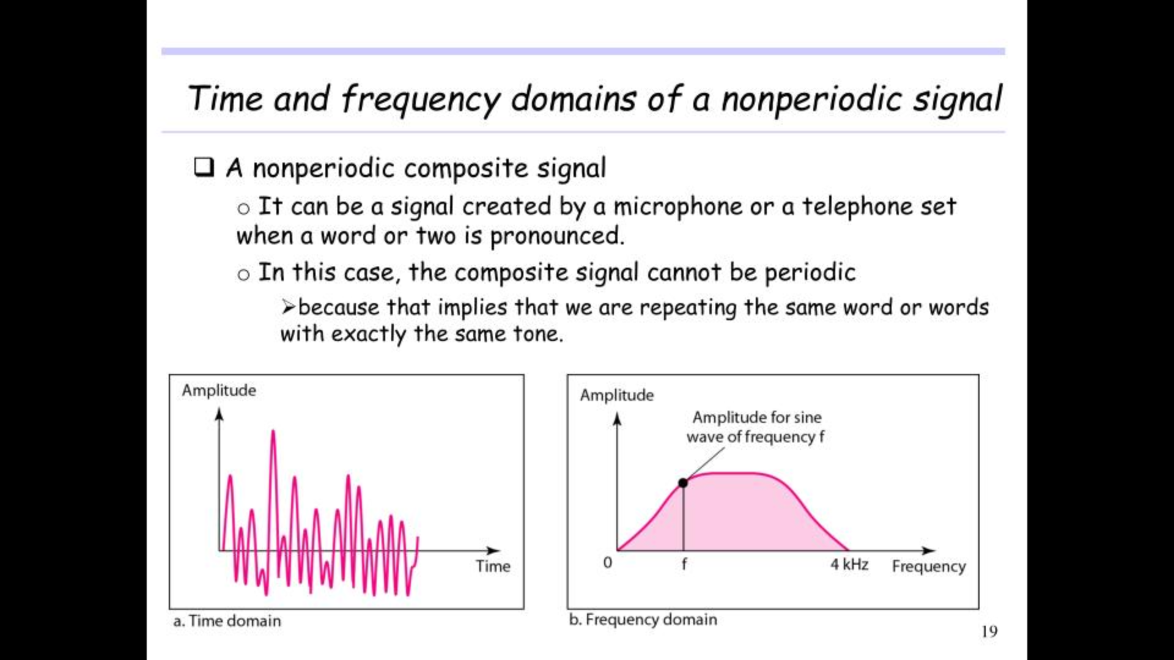

Slide 21
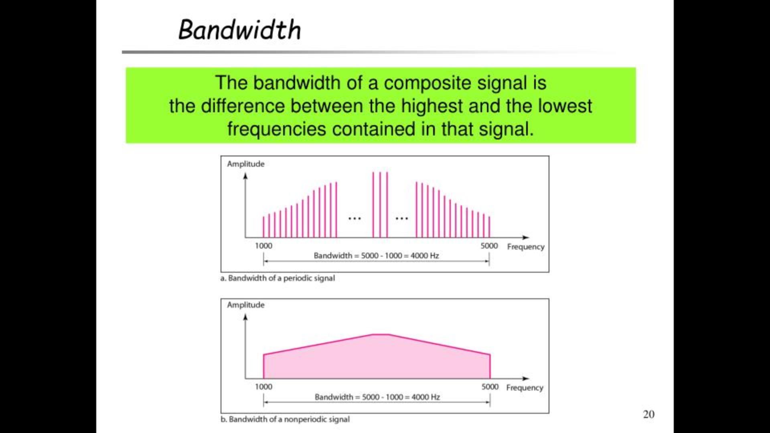
Notes:
The range of frequencies contained in a composite signal is its bandwidth

Slide 22
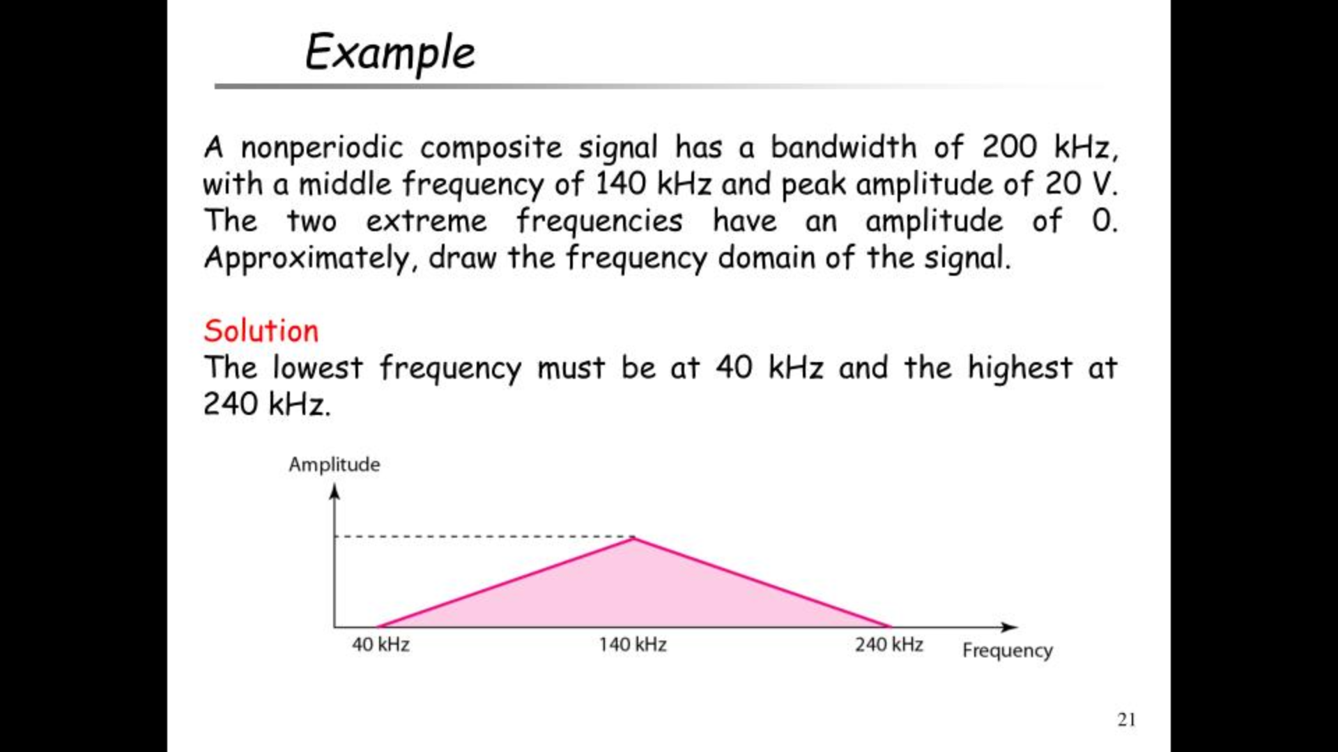

Slide 23
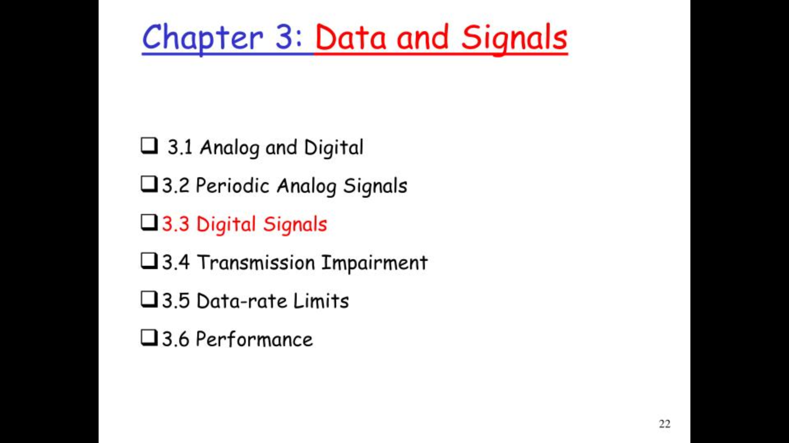

Slide 24
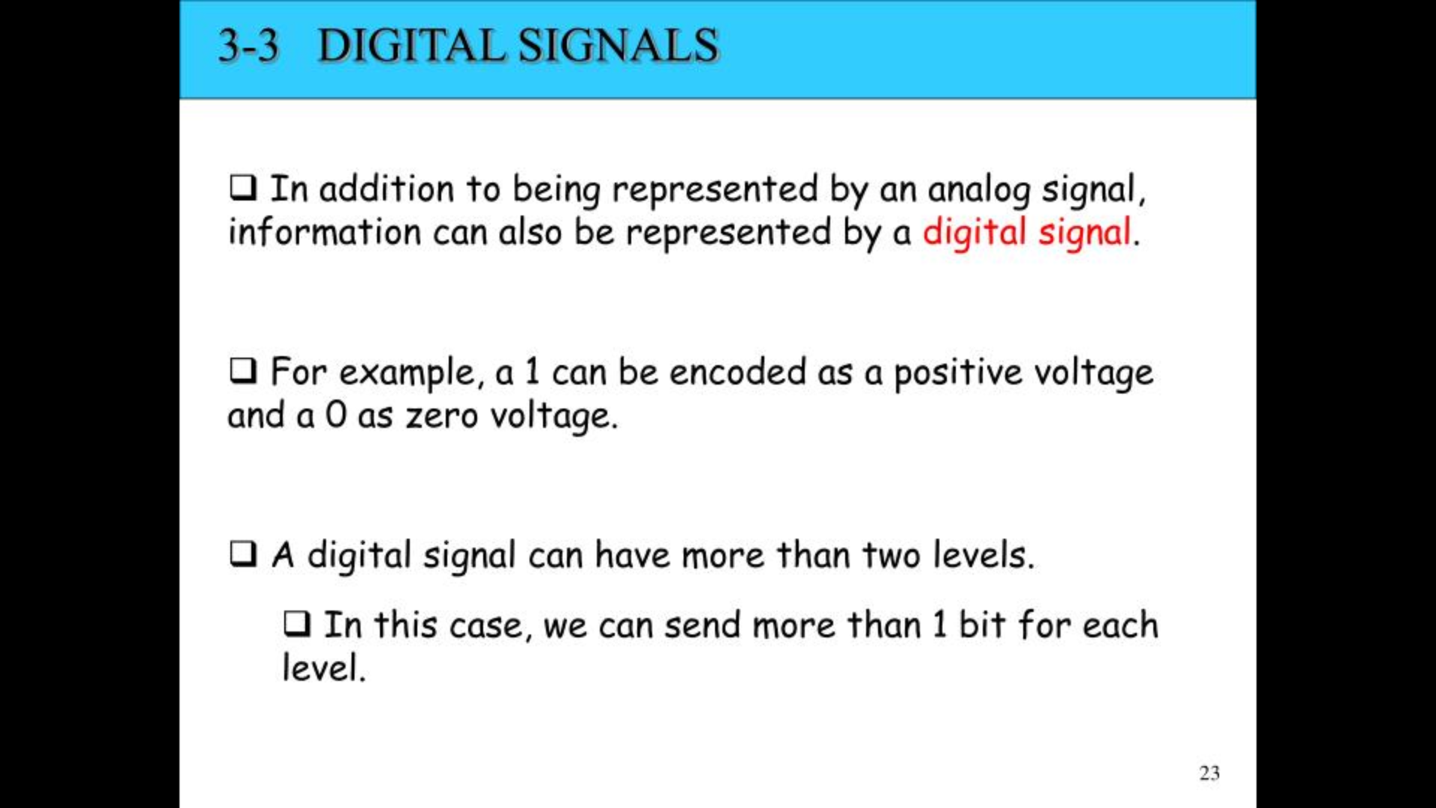

Slide 25
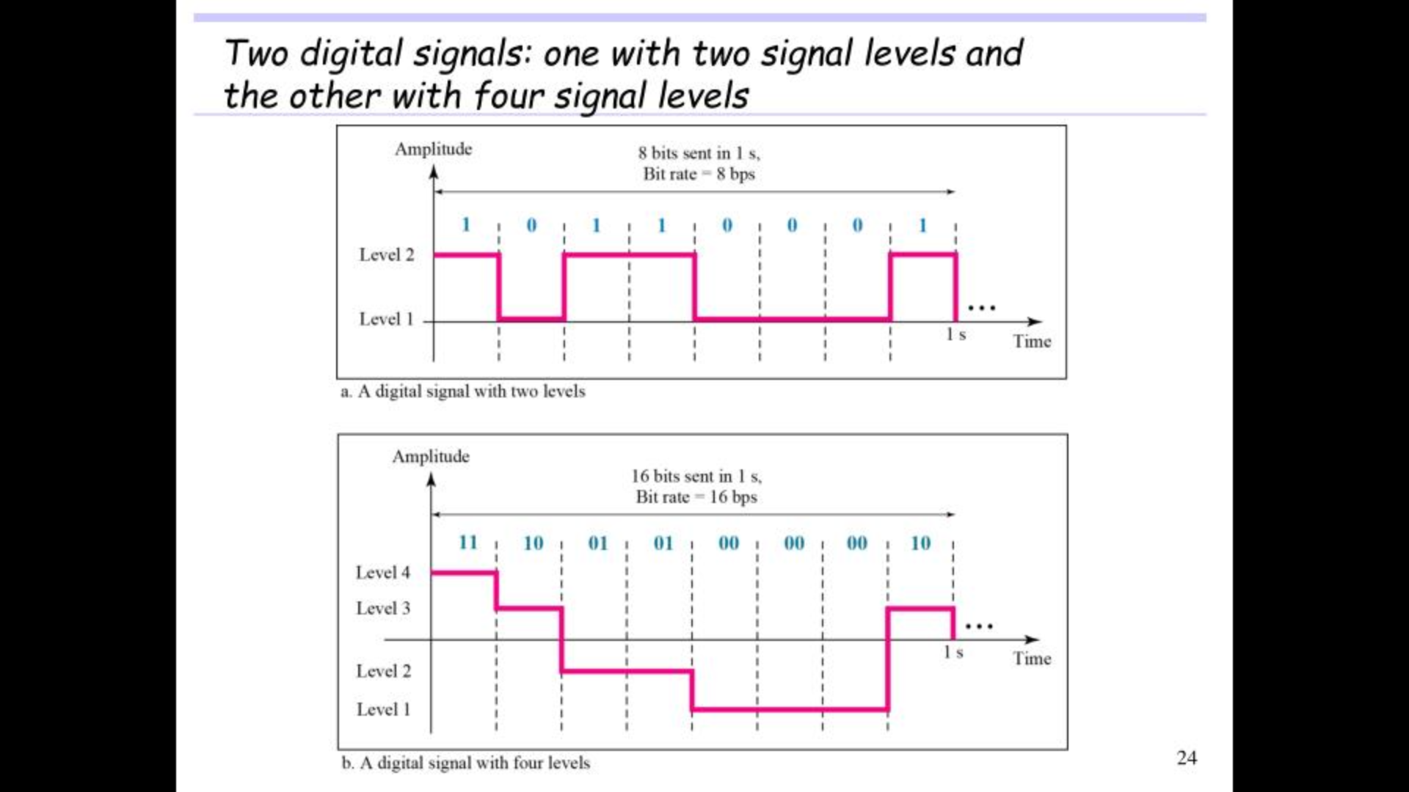

Slide 26
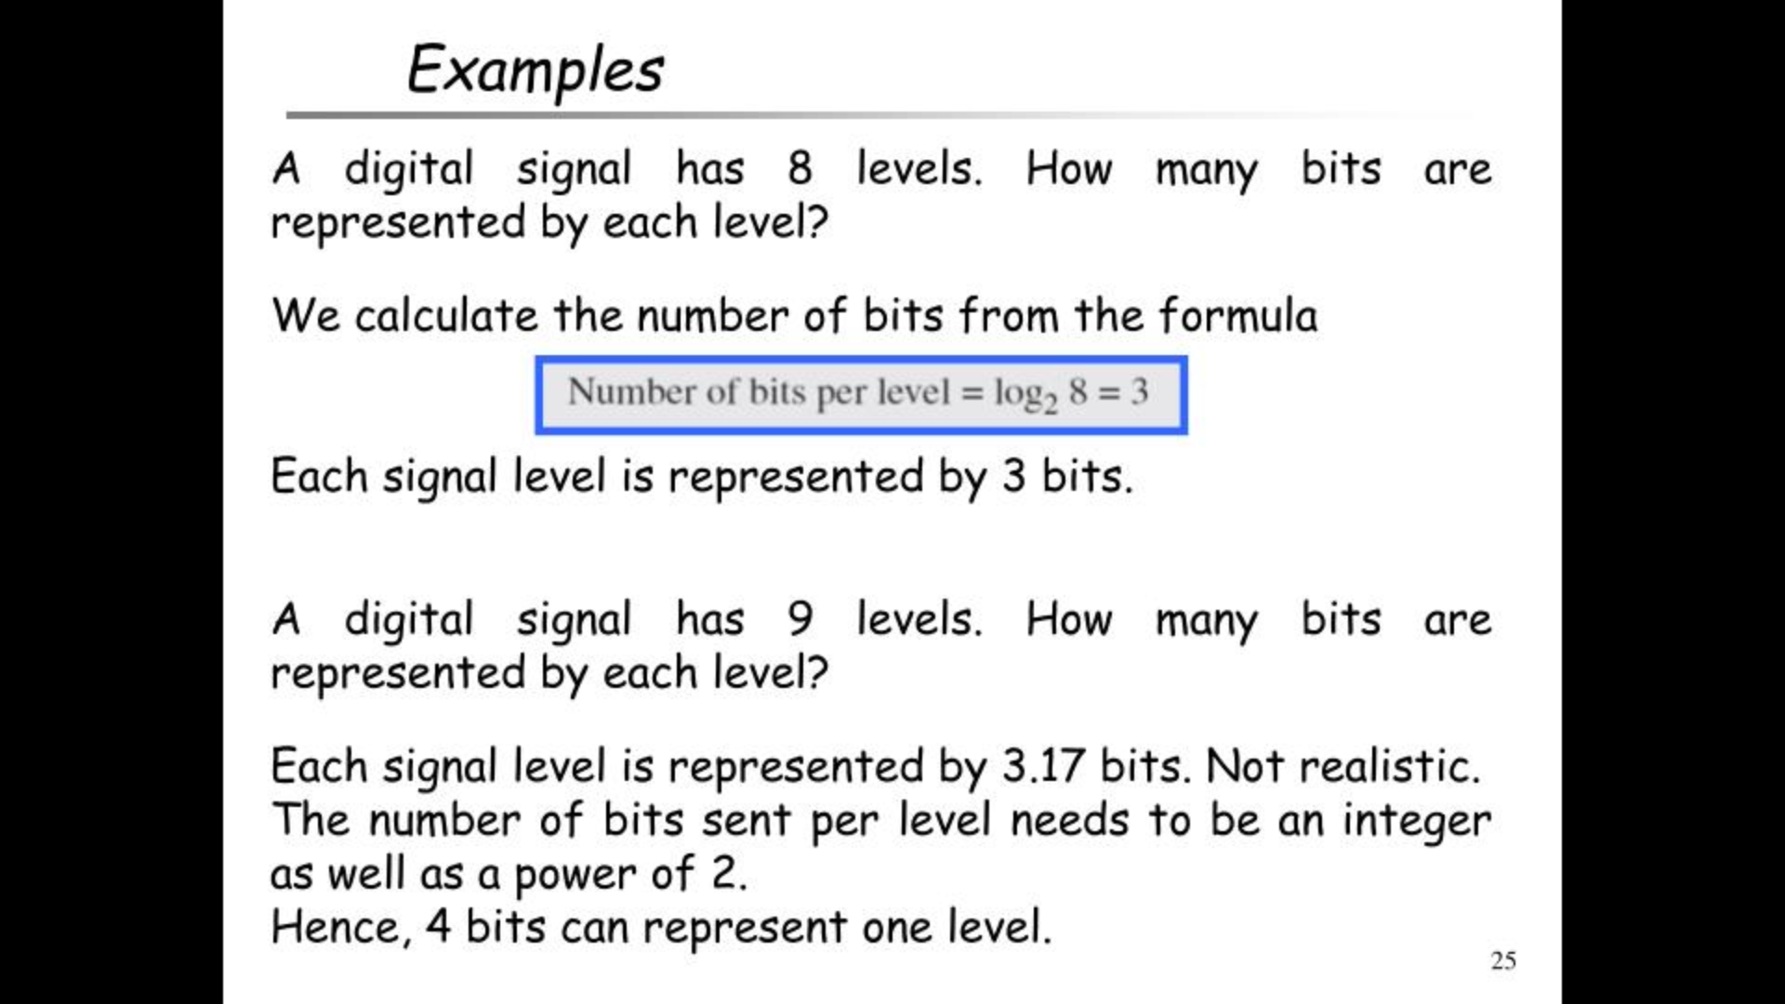
Notes:
The LOG2() function returns the natural logarithm of a number to base-2.

Slide 27
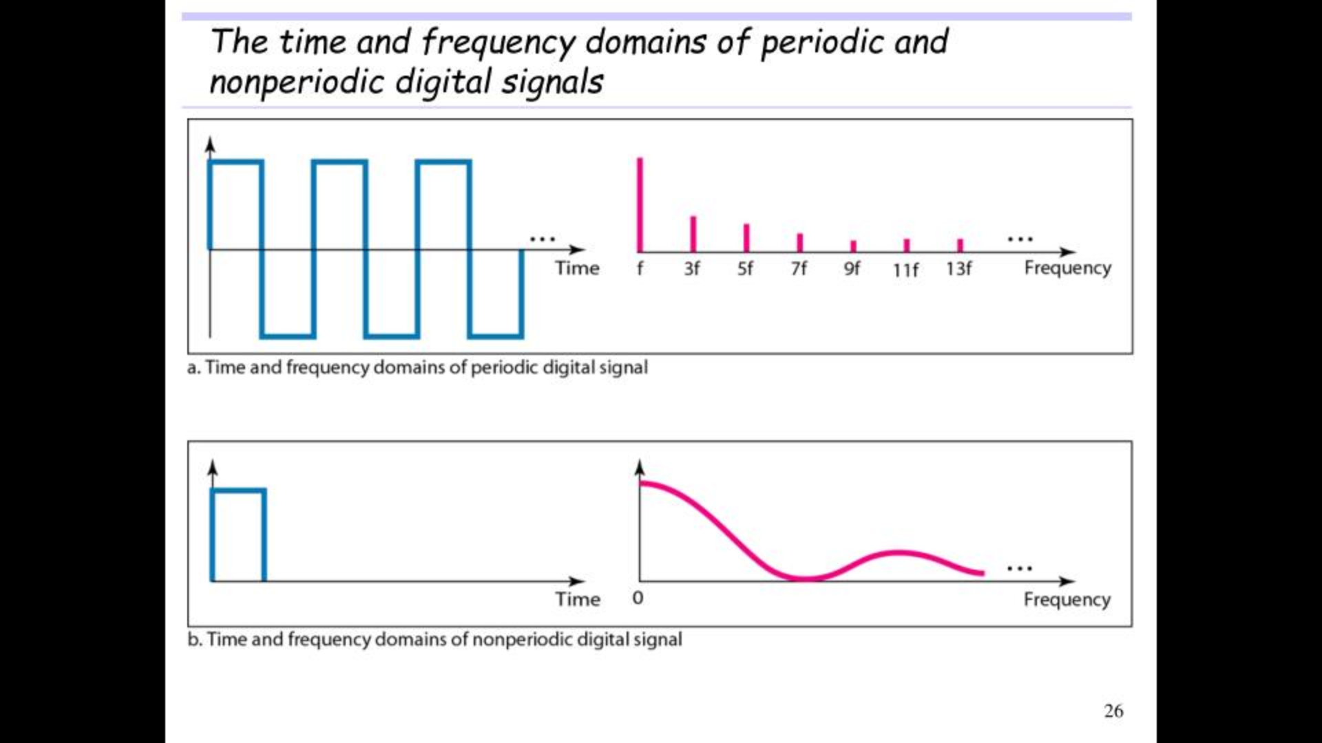

Slide 28


Slide 29
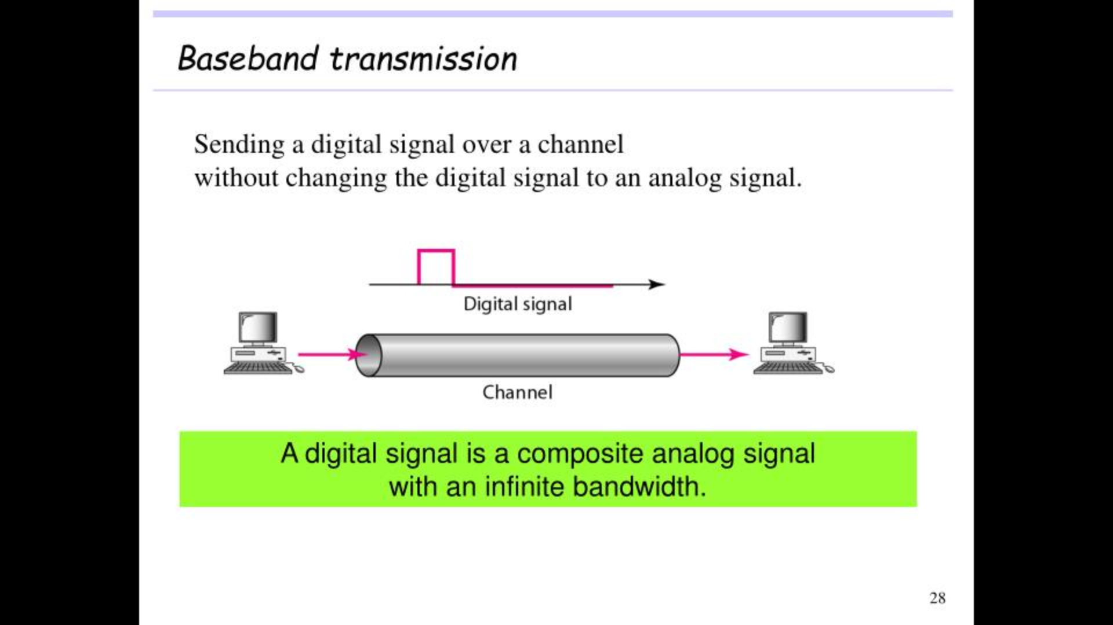

Slide 30
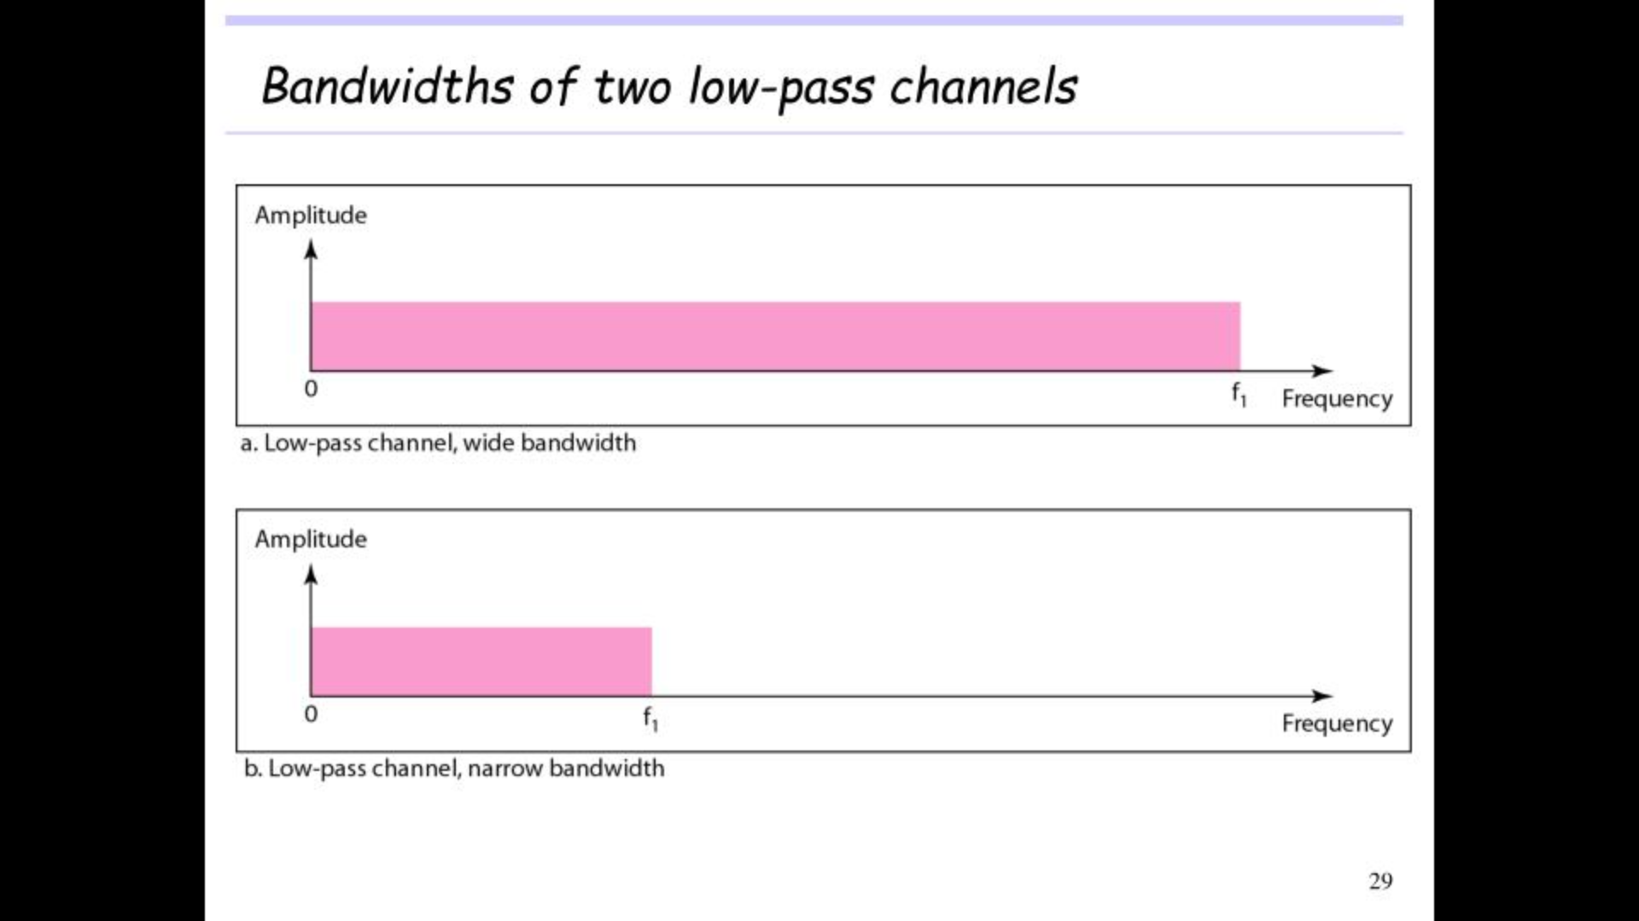
Notes:
Low-Pass Channel with Wide Bandwidth: Although this may be possible inside a computer (e.g., between CPU and memory), it is not possible between two devices. Fortunately, the amplitudes of the frequencies at the border of the bandwidth are so small that they can be ignored. This means that if we have a medium, such as a coaxial or fiber optic cable, with a very wide bandwidth, two stations can communicate by using digital signals with very good accuracy
Low-Pass Channel with Limited Bandwidth: In a low-pass channel with limited bandwidth, we approximate the digital signal with an analog signal. The level of approximation depends on the bandwidth available.

Slide 31
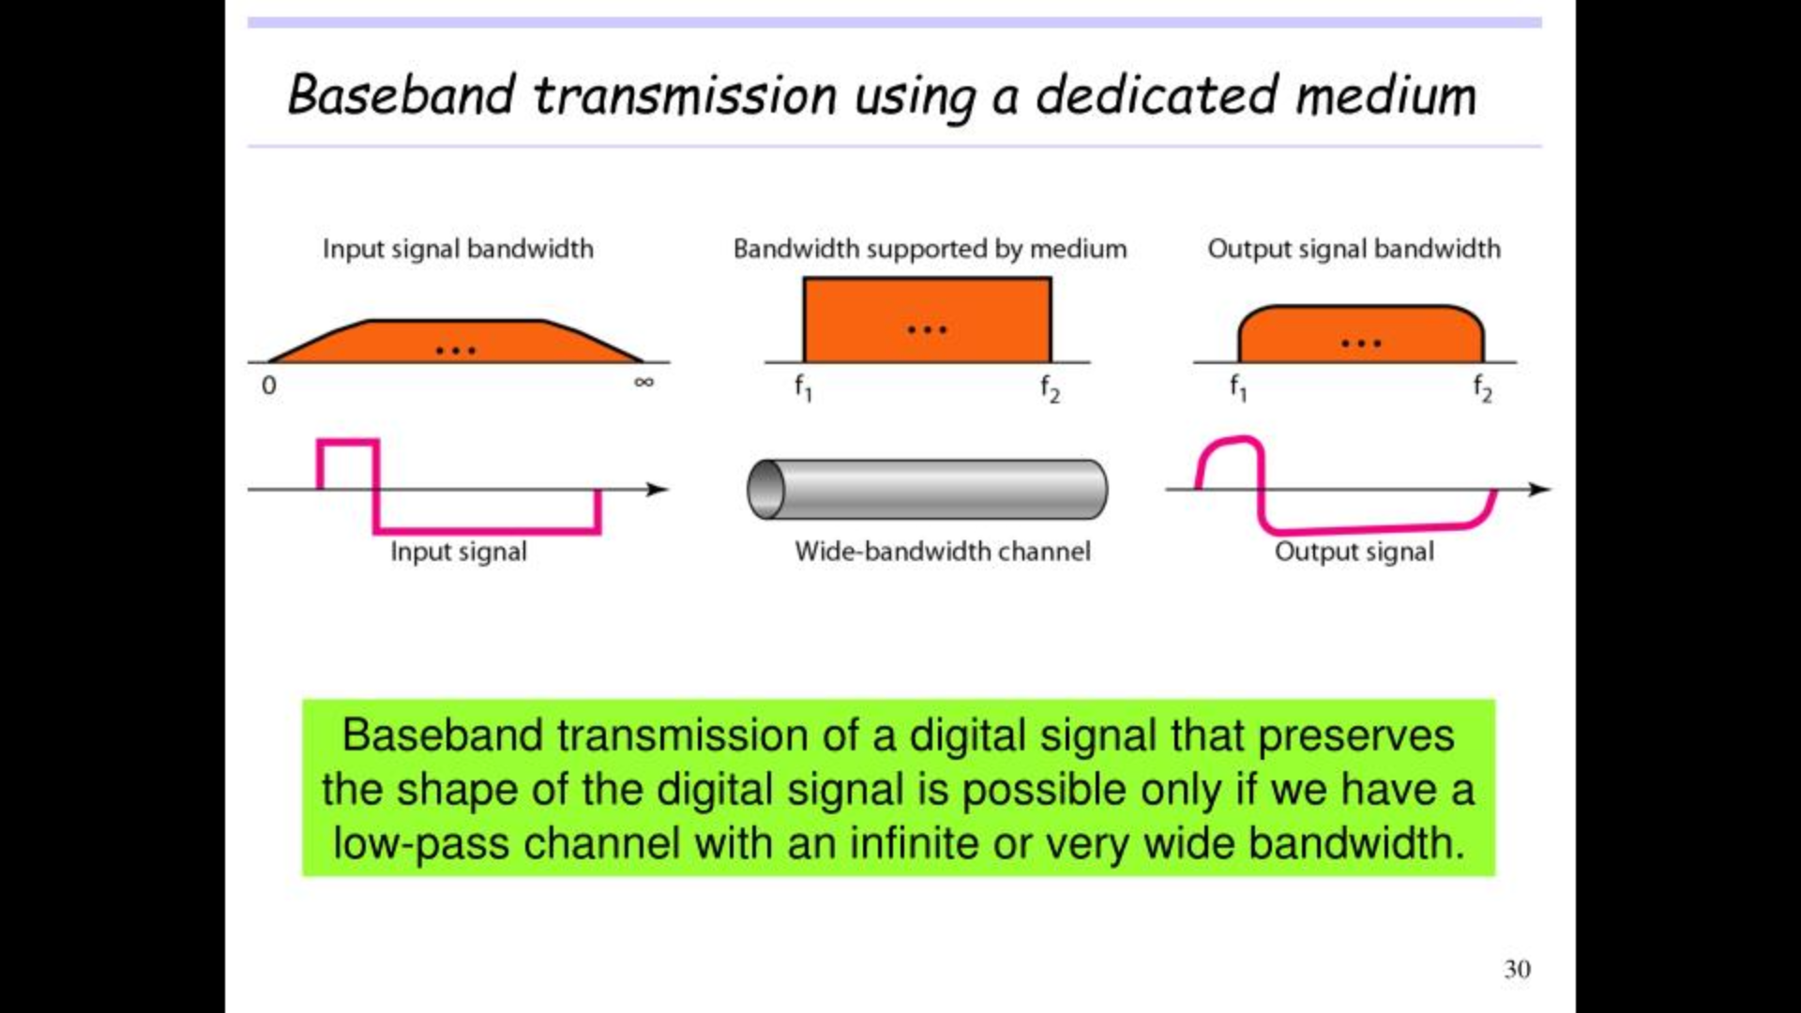

Slide 32
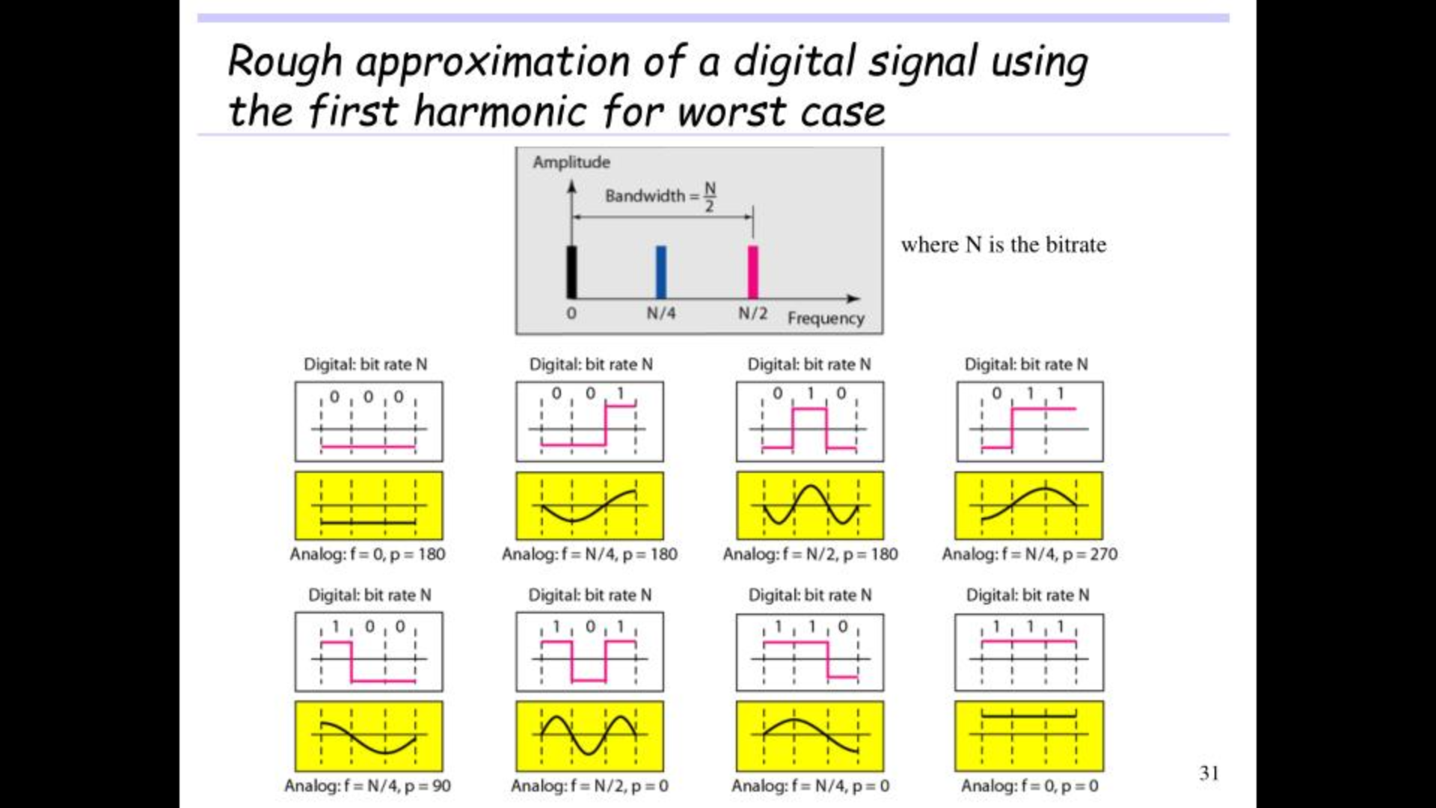

Slide 33
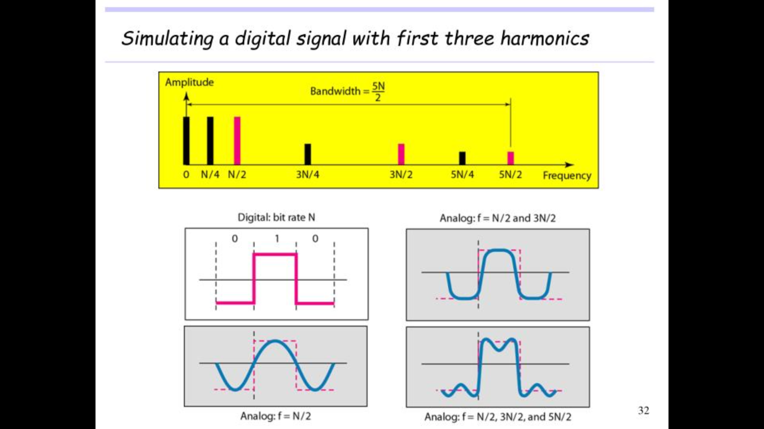

Slide 34
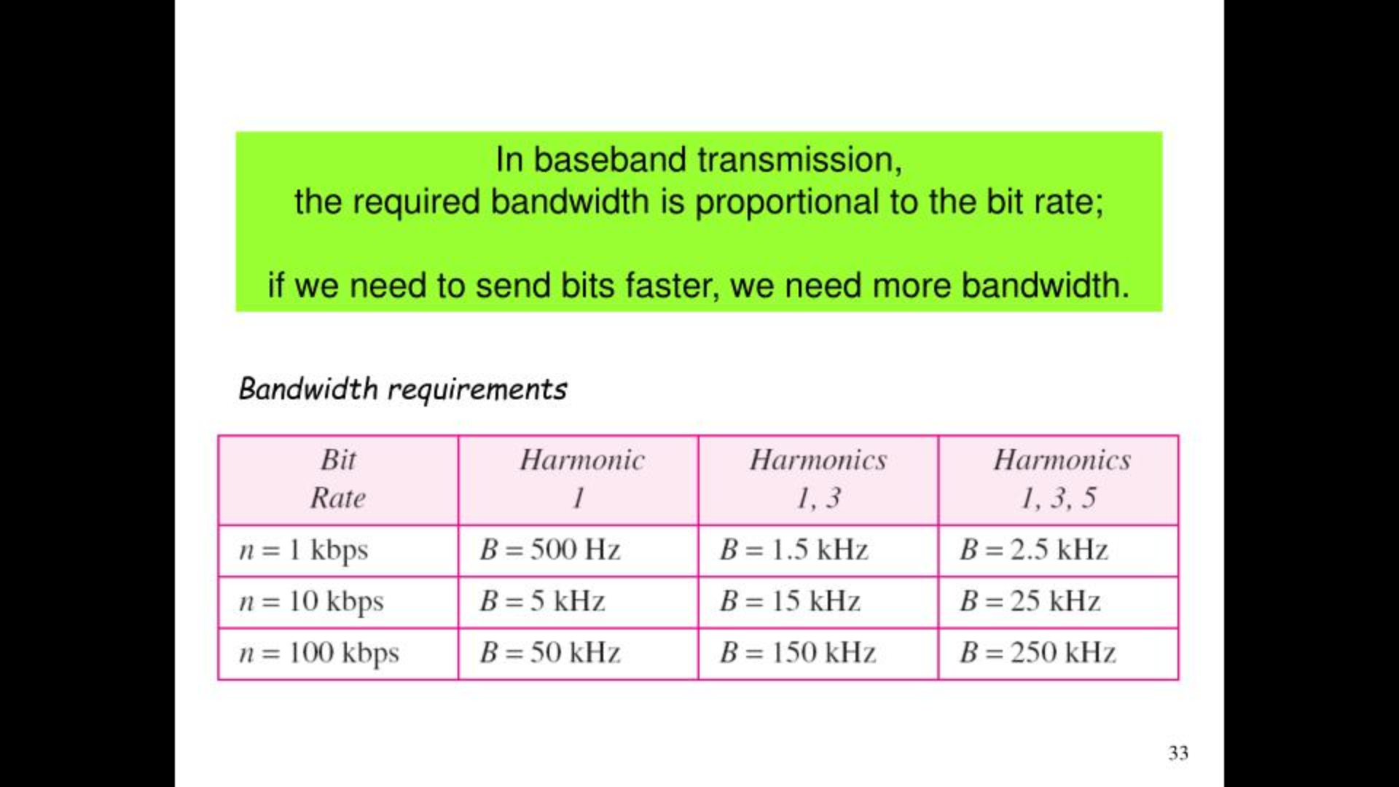

Slide 35
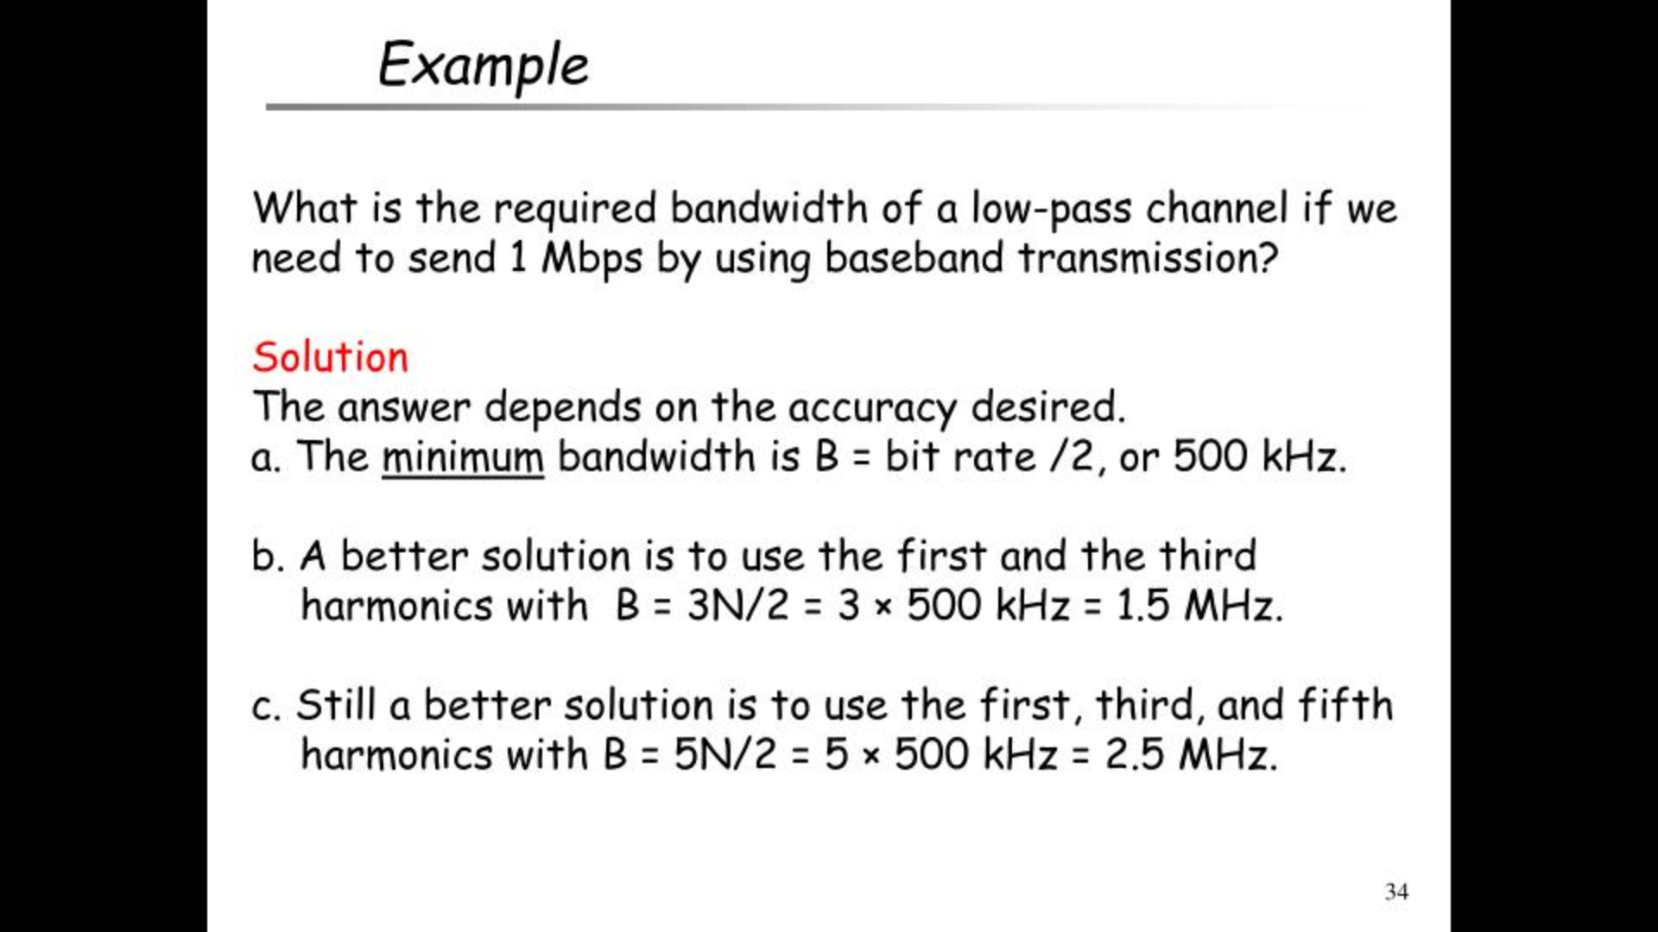

Slide 36
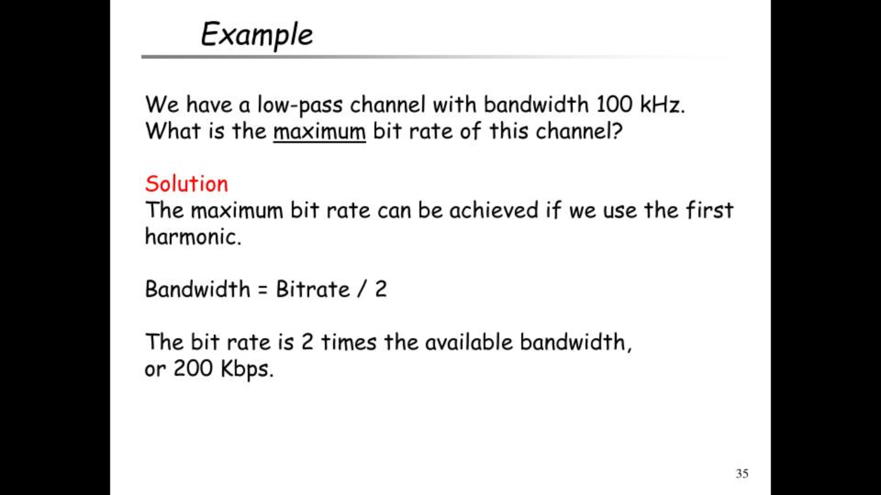

Slide 37
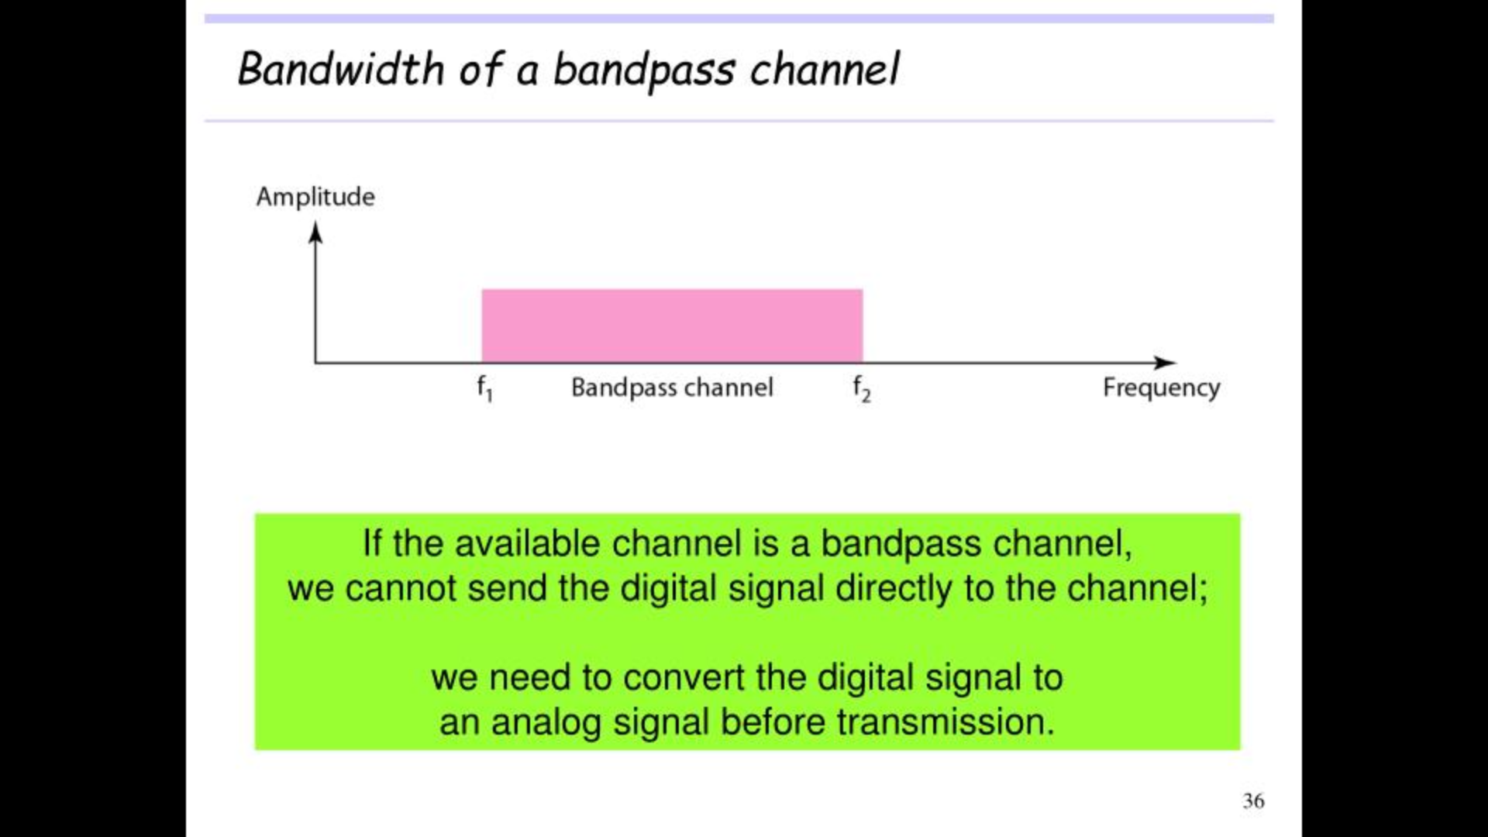
Notes:
A bandpass channel is a channel whose bandwidth does not start from Zero.

Slide 38
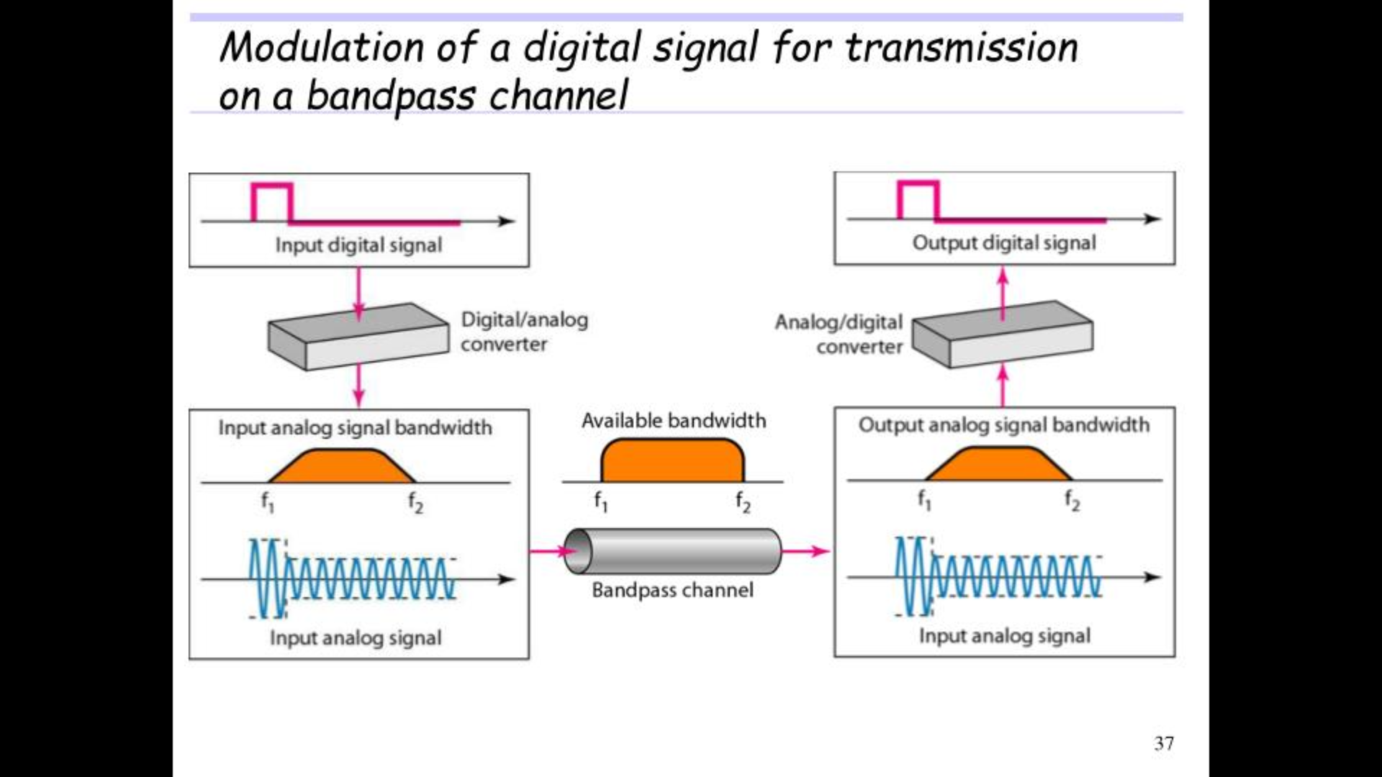
Notes:
Modulation:
Is the process of converting data into electrical signals optimizing for transmission.
Method of modulation : Analog, Digital, Pulse, Spread modulation
Digital modulation:
Digital modulation is the process of encoding a digital information signal into the amplitude, phase or frequency of the transmitted signal
The encoding process affects the bandwidth of the transmitted signal and its robustness to channel impairments.
Analog modulation:
The process of transferring an analog baseband (low frequency) signal, like an audio or TV signal over a higher frequency signal such as a radio frequency band.

Slide 39
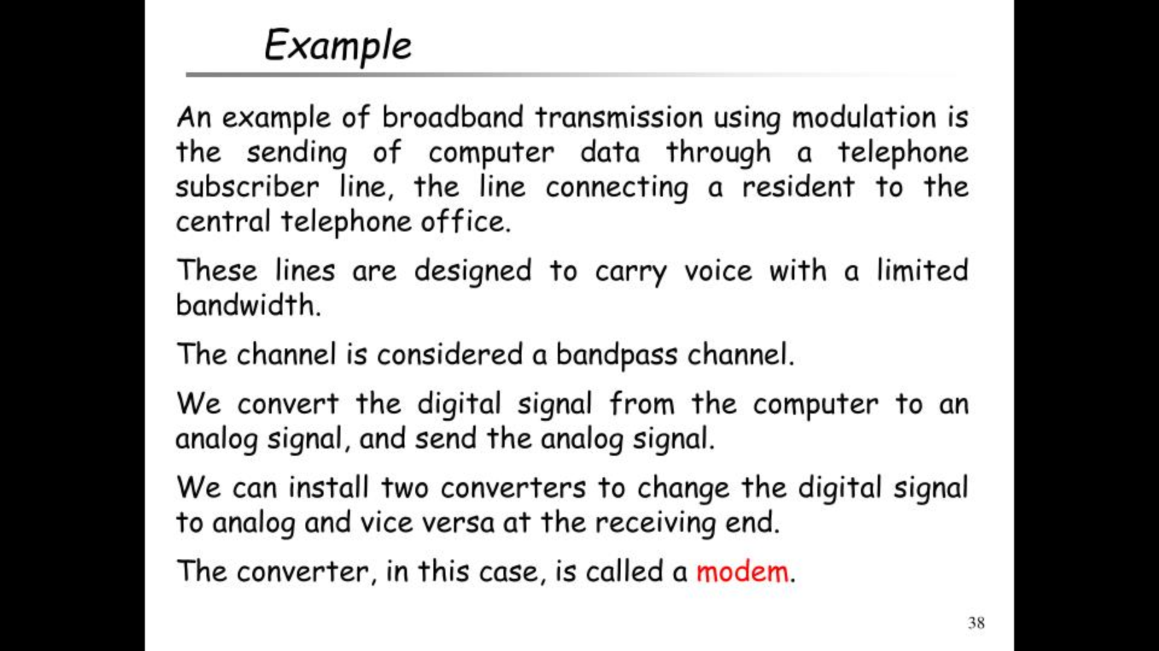

Slide 40
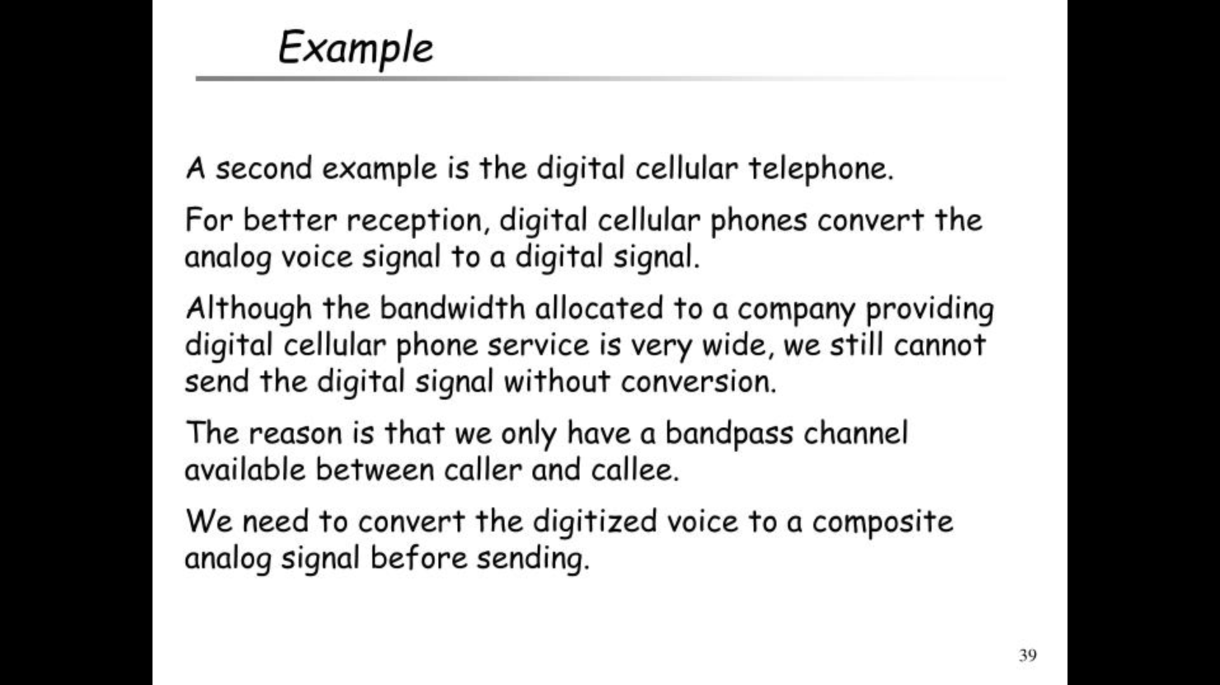

Slide 41
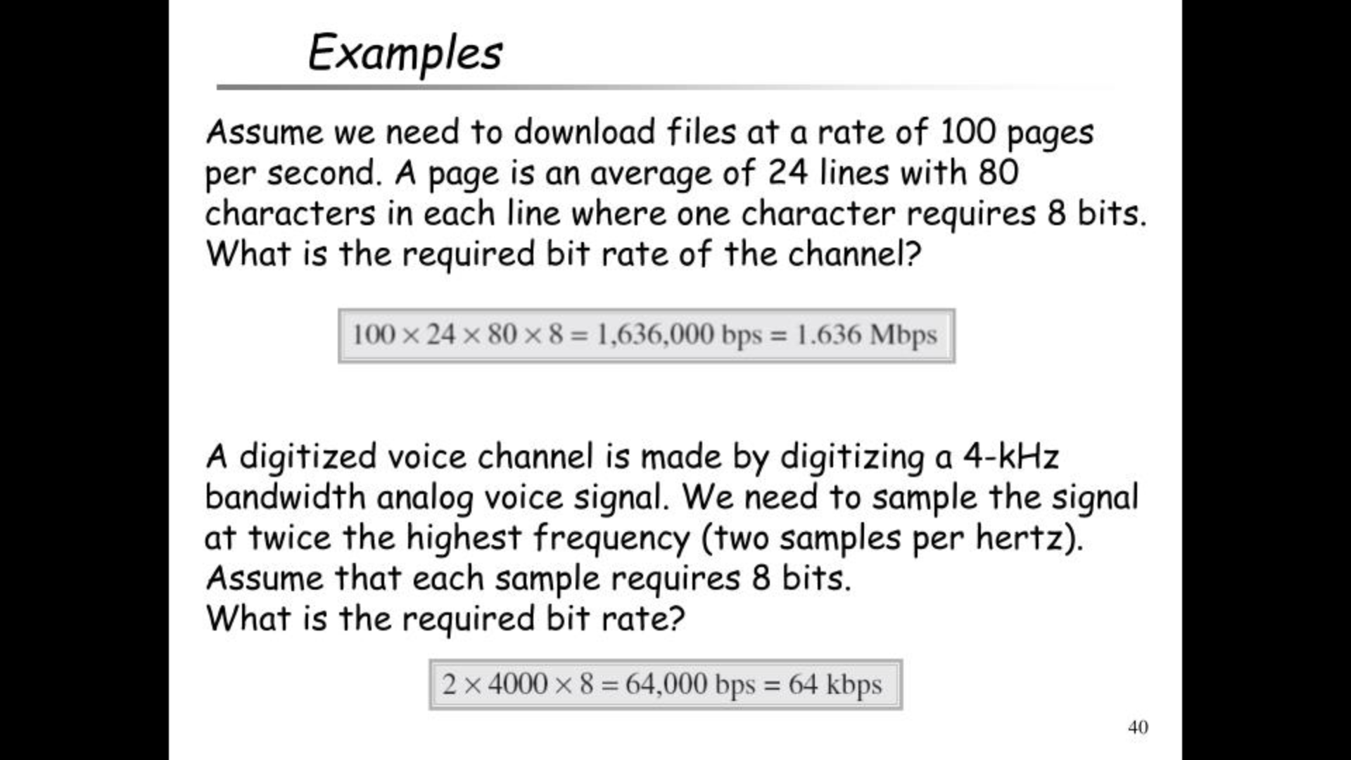

Slide 42
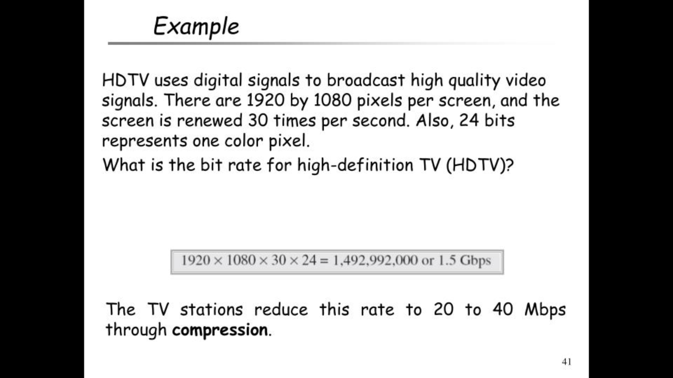

Slide 43
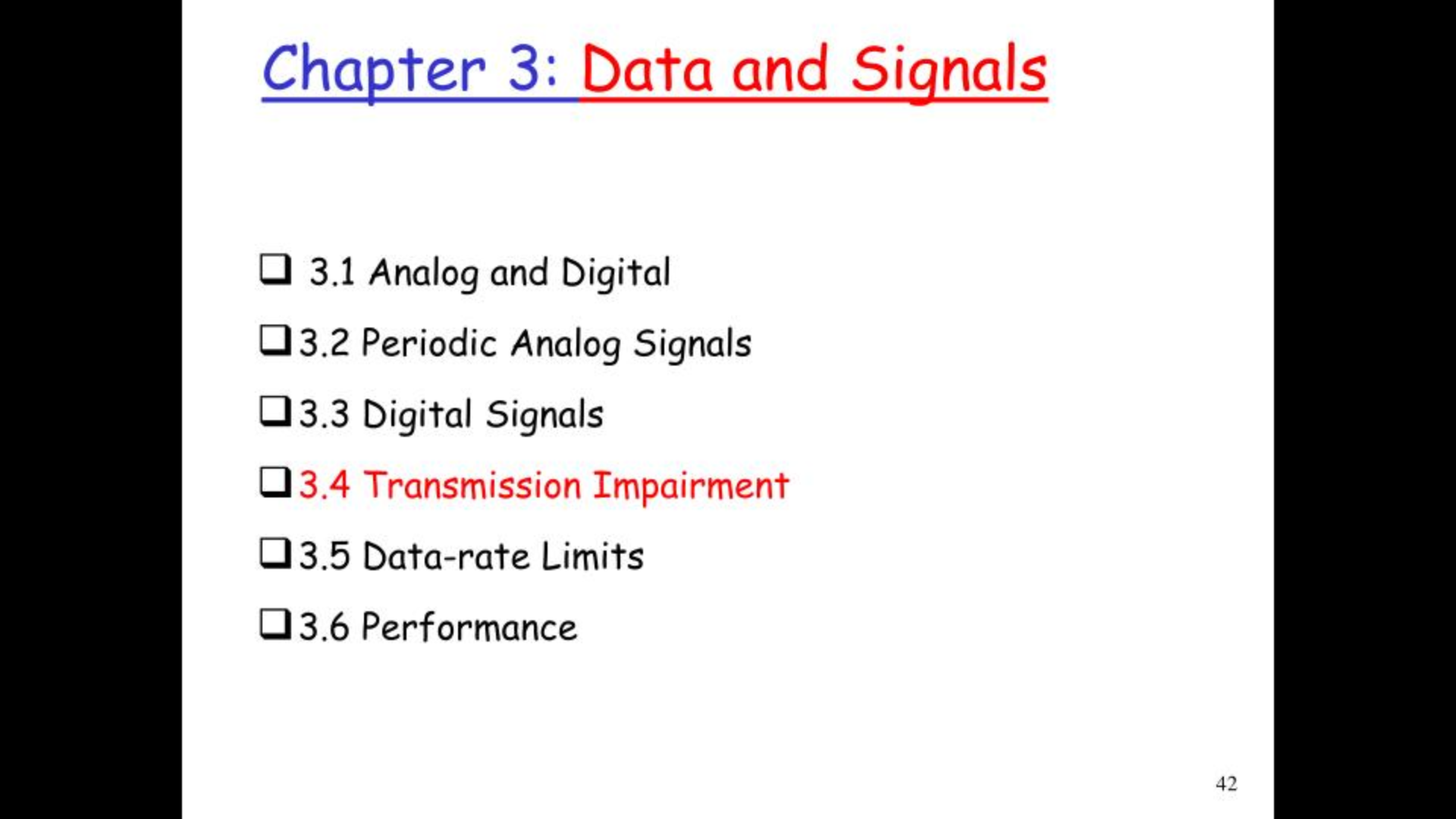

Slide 44
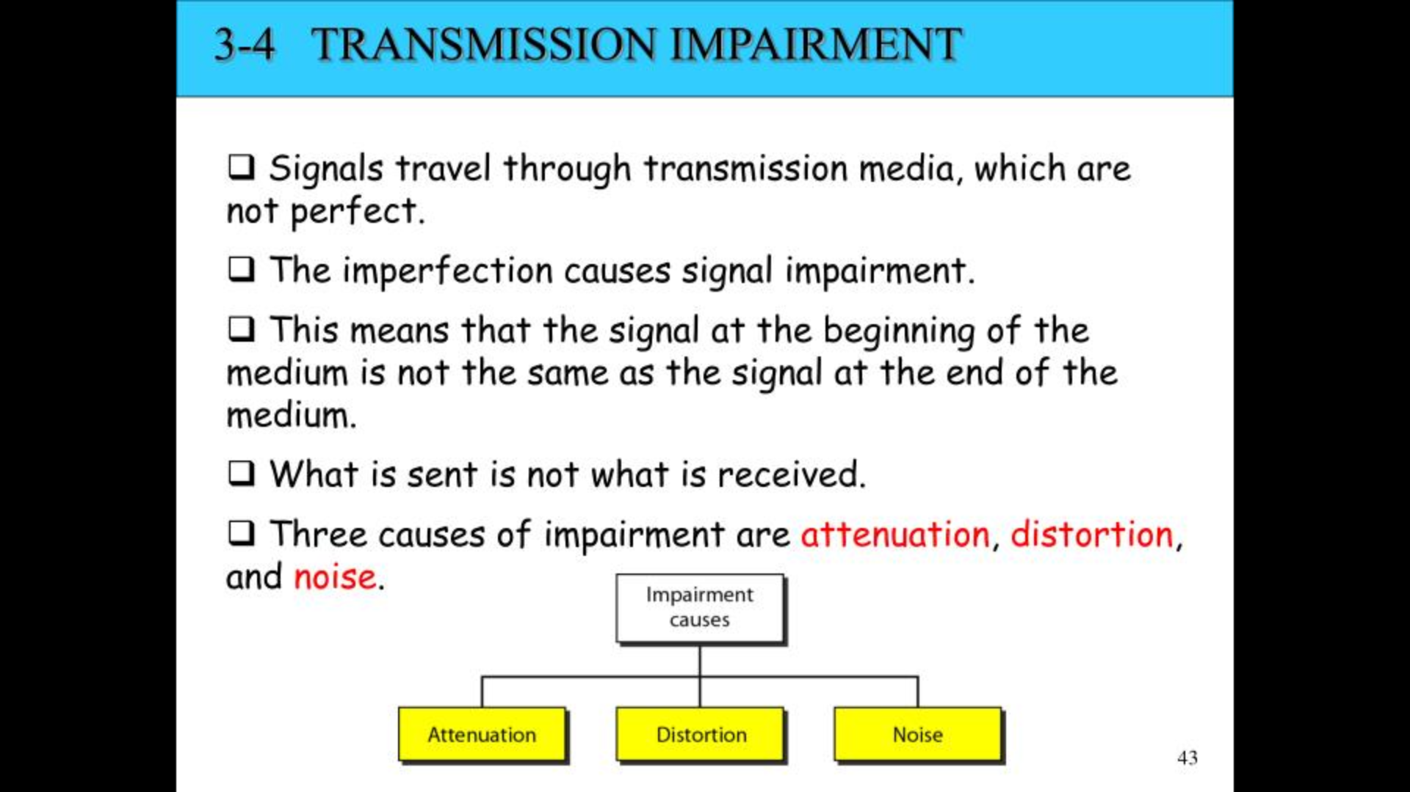

Slide 45
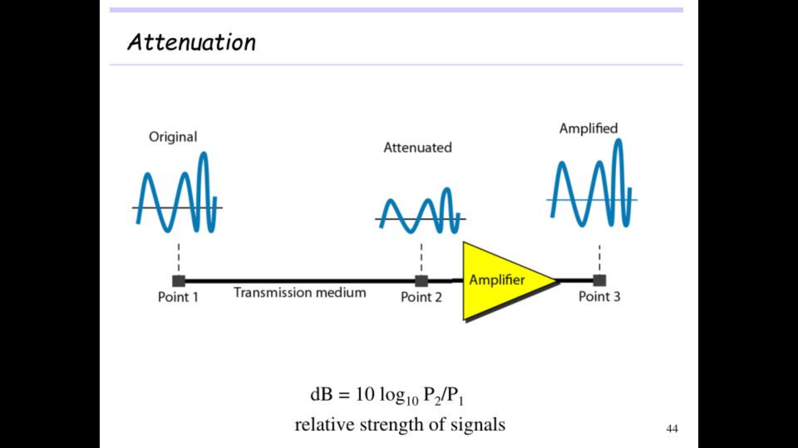

Slide 46
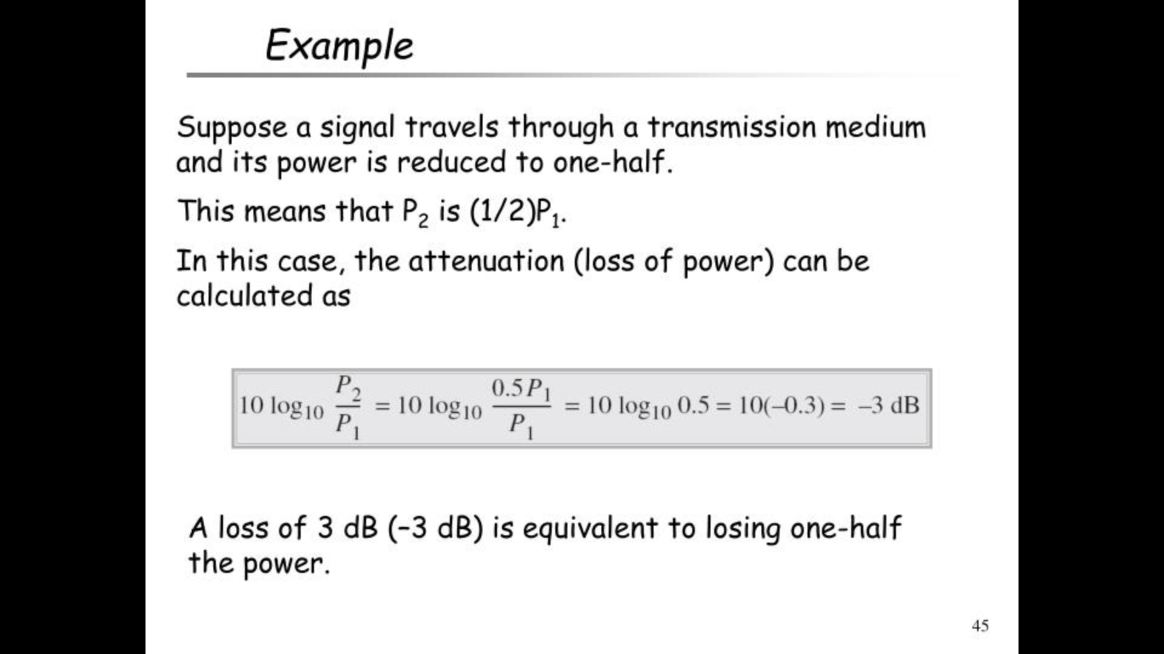

Slide 47
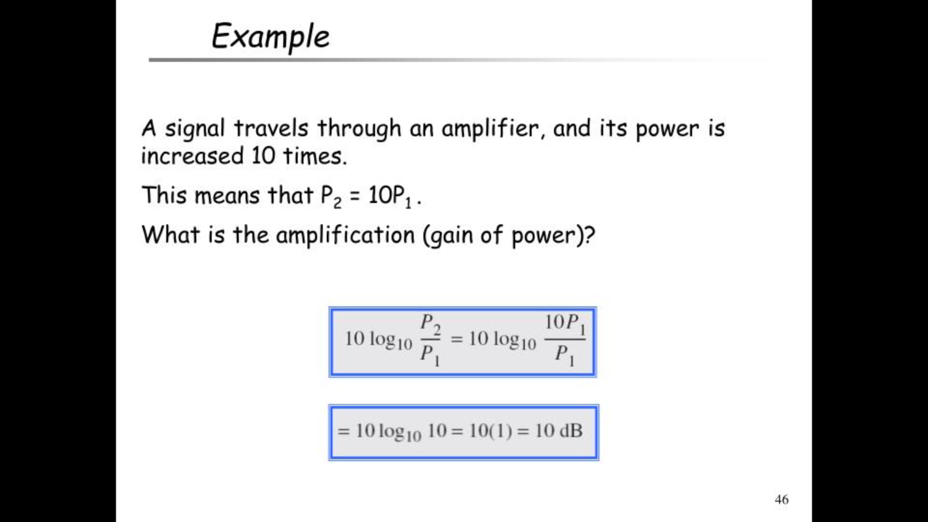

Slide 48
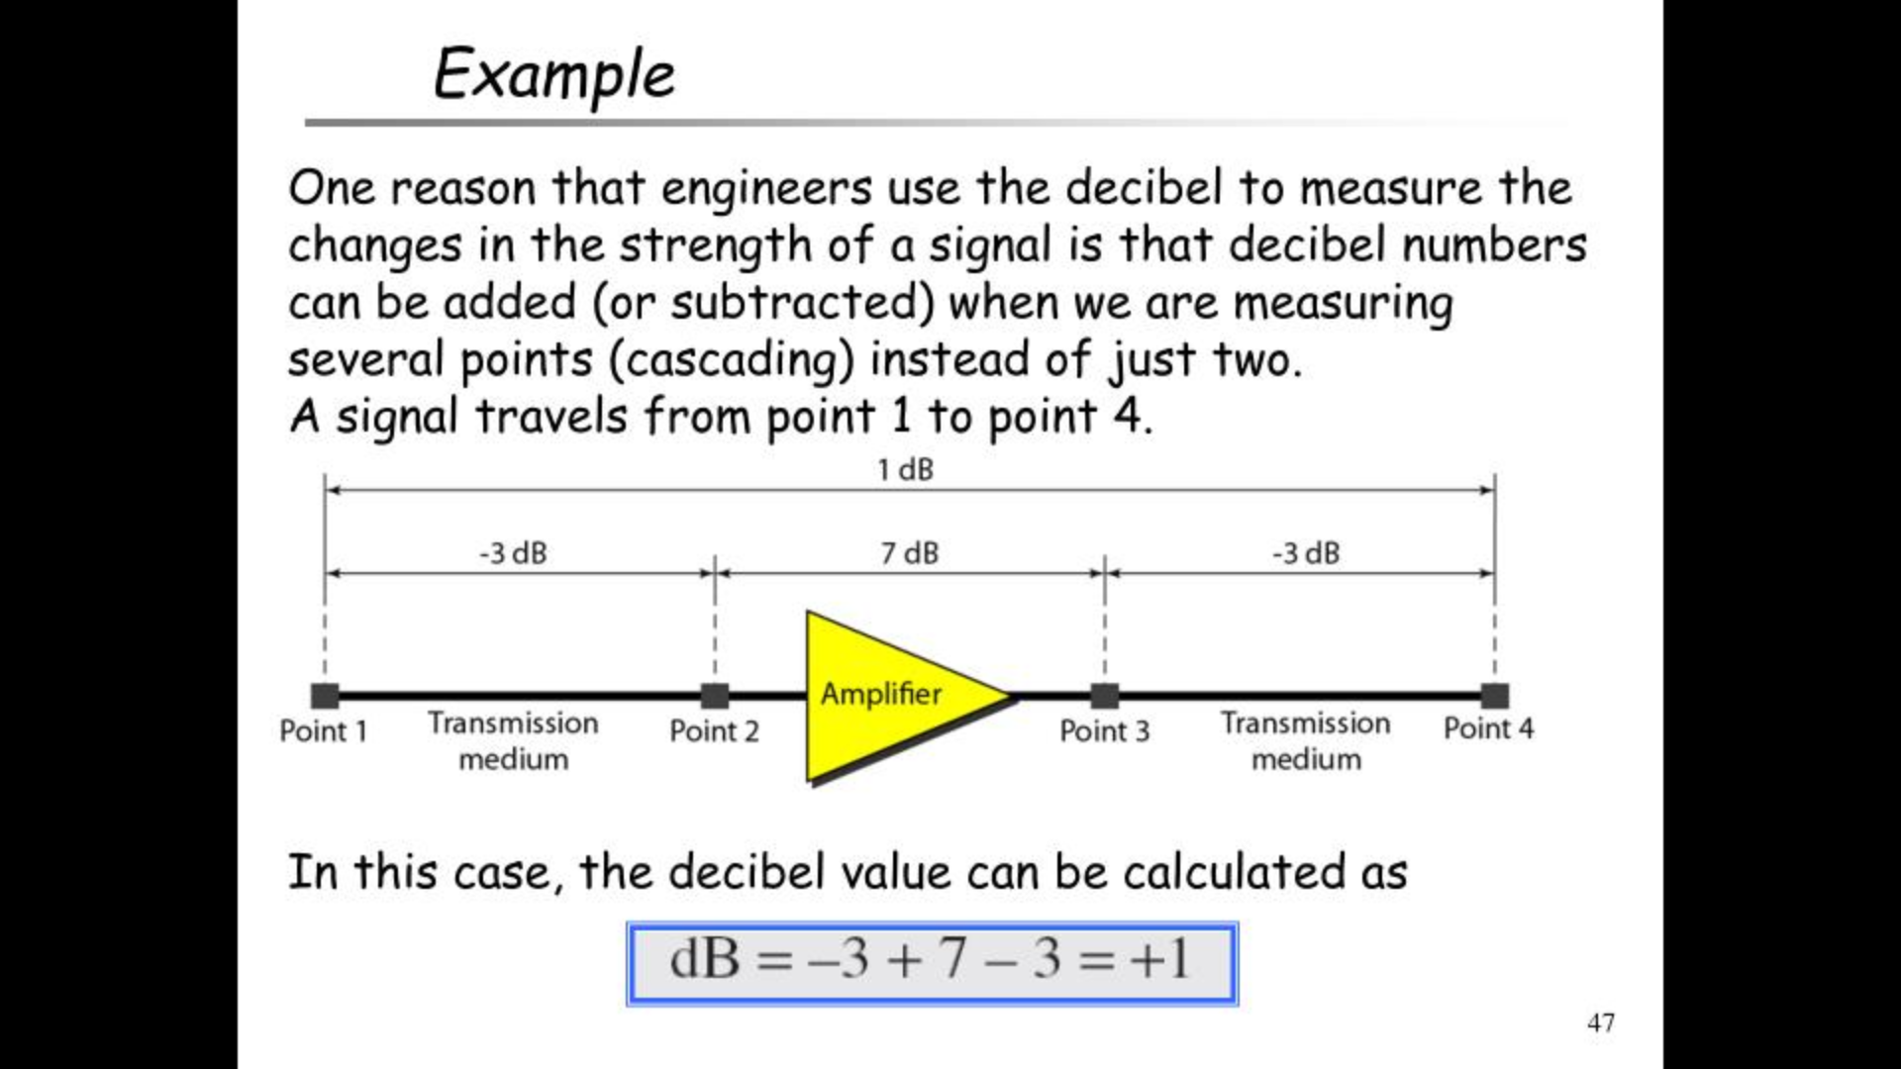

Slide 49
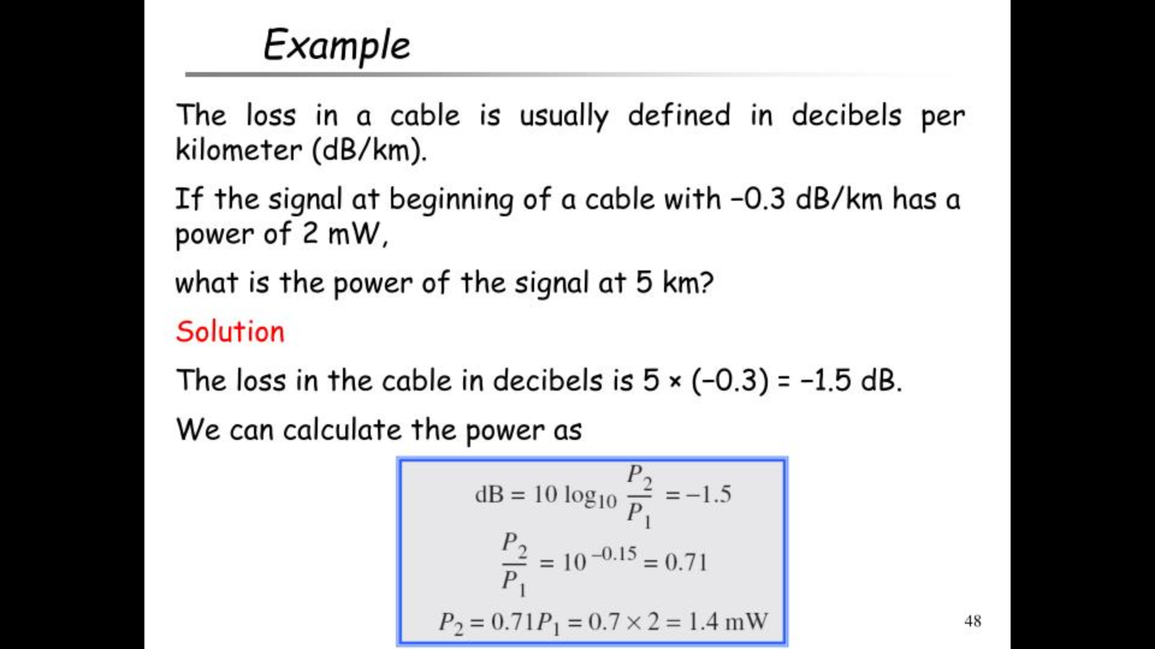

Slide 50
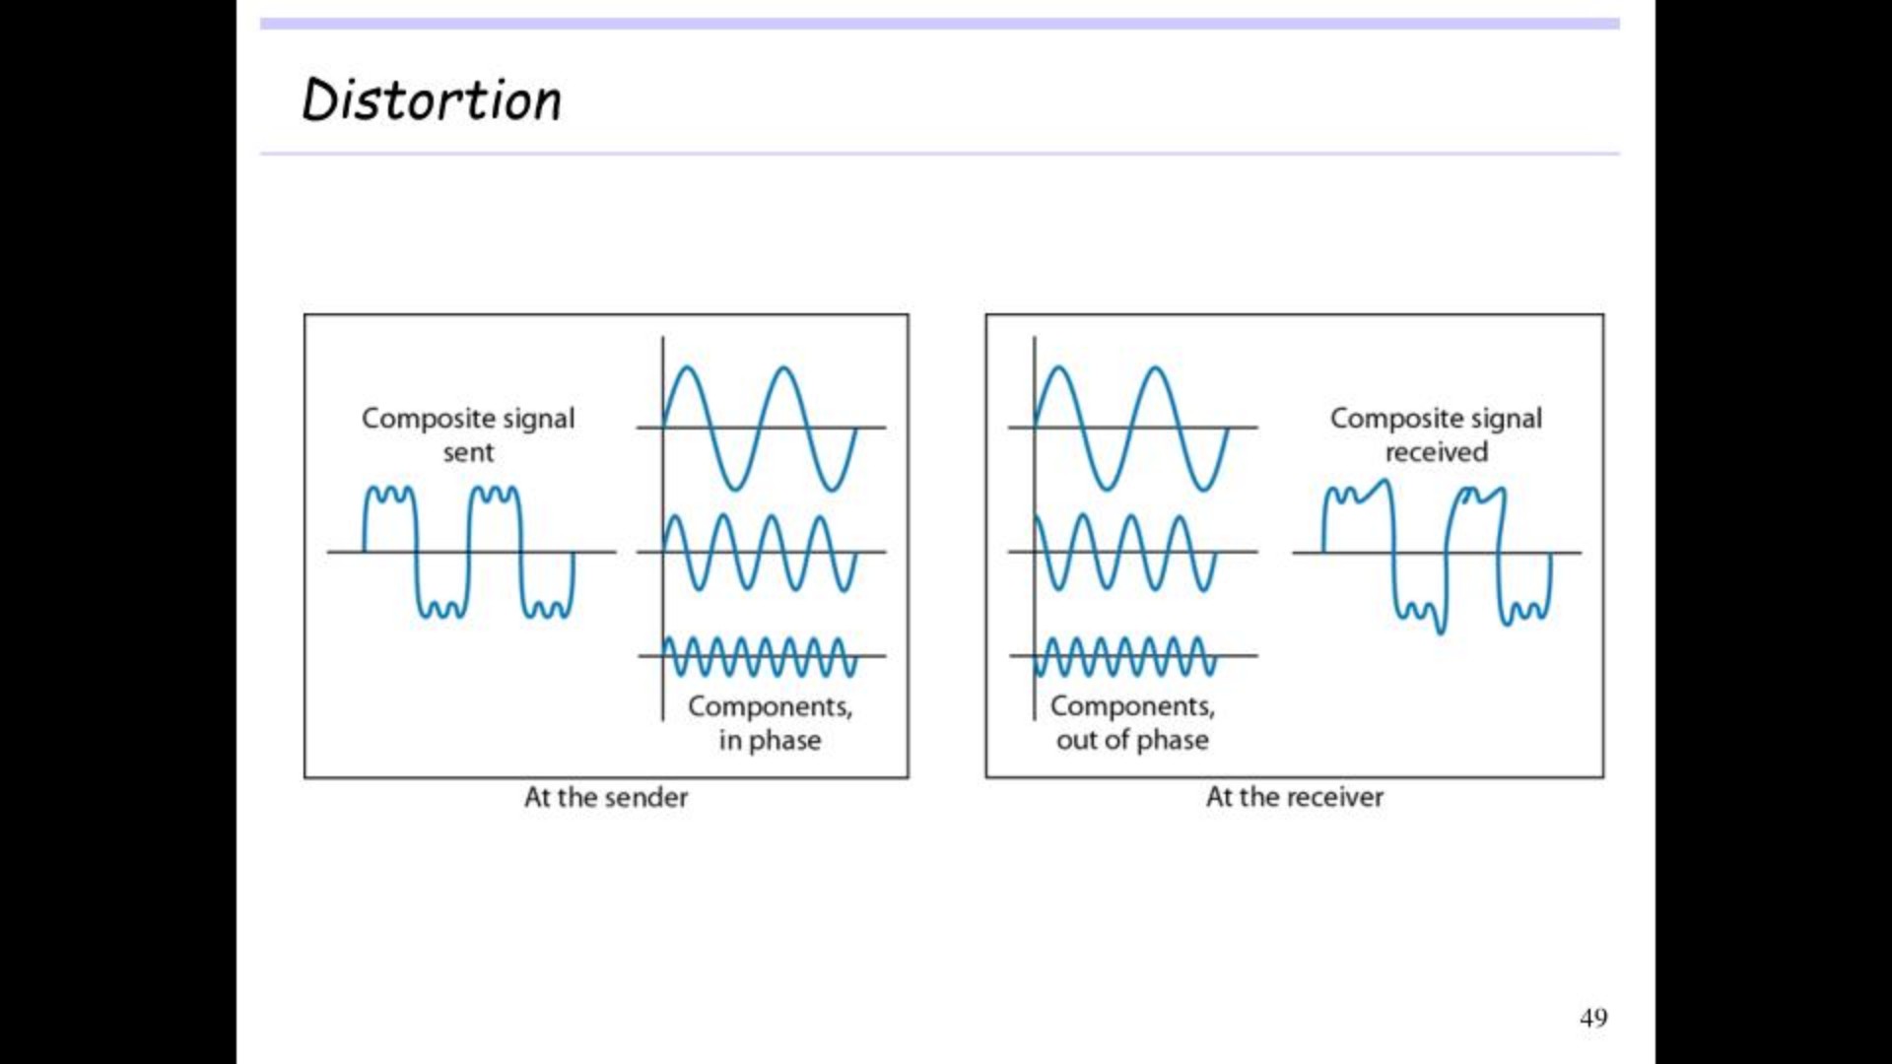

Slide 51
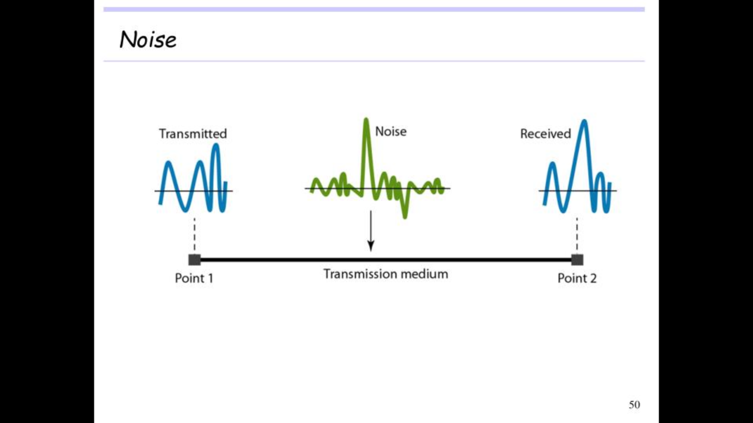

Slide 52


Slide 53


Slide 54


Slide 55


Slide 56


Slide 57


Slide 58


Slide 59


Slide 60


Slide 61


Slide 62


Slide 63


Slide 64


Slide 65


Slide 66


Slide 67


Slide 68


Slide 69


Slide 70


Slide 71


Slide 72


Slide 73


Slide 74


Slide 75


Slide 76


Slide 77


Slide 78


Slide 79


Slide 80


Slide 81


Slide 82


